Slide 1
This PowerPoint is a supplement to Lesson 1 of the Excellence in Exhibition: Preventing Disease in Animals and People course.
Notes:
Welcome to Excellence in Exhibition: Preventing Disease in Animals and People!
Animal agriculture is an important part of 4-H and FFA. Being a part of these organizations helps you gain knowledge about animals and develop responsibility, good sportsmanship, and confidence. However, there are many diseases that can be spread between people and animals, and knowing about these diseases is especially important because of the close contact that you have with your show animals.
This course was created to teach you how to keep yourself and your animals safe and healthy so that you can continue to enjoy showing and teaching others about animal agriculture.

Slide 2
Acknowledgements
Iowa Department of Public Health receives funding for this project through a joint organizational partnership between the Council of State and Territorial Epidemiologists (CSTE) and the Centers for Disease Control and Prevention (CDC), provided by CSTE through sub-awards from the CDC cooperative agreement number: 5U38OT00143. The contents of this project are solely the responsibility of the authors and do not necessarily represent the official views of CDC or CSTE.
Notes:
Photos sources located in online version of lessons at www.bluenotflu.org

Slide 3
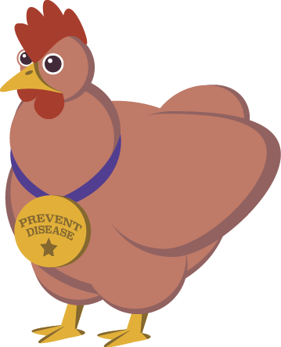
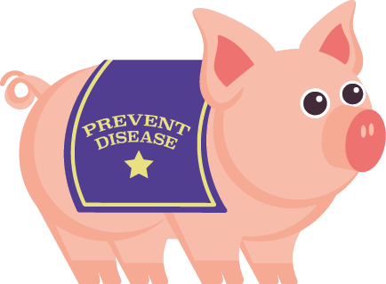
Introduction to Influenza, Zoonoses, and Disease Risks
Notes:
Lesson 1 focuses on influenza and other zoonoses and why it is important to learn about them. The diseases you will learn about can be spread between people and animals, especially when you are in close contact with your animals. This lesson will teach you about what diseases could affect you and your animals. Knowing these diseases will help you be on the lookout for any signs of illness in your animals or yourself. Keeping both yourself and your animals healthy will make showing animals a more enjoyable experience.

Slide 4
Learning Objectives
Define zoonoses.
Describe the importance of influenza and other zoonoses.
Recognize common zoonotic diseases that might affect people and animals at fairs or exhibitions.
Identify risk factors for zoonotic disease infection.

Slide 5
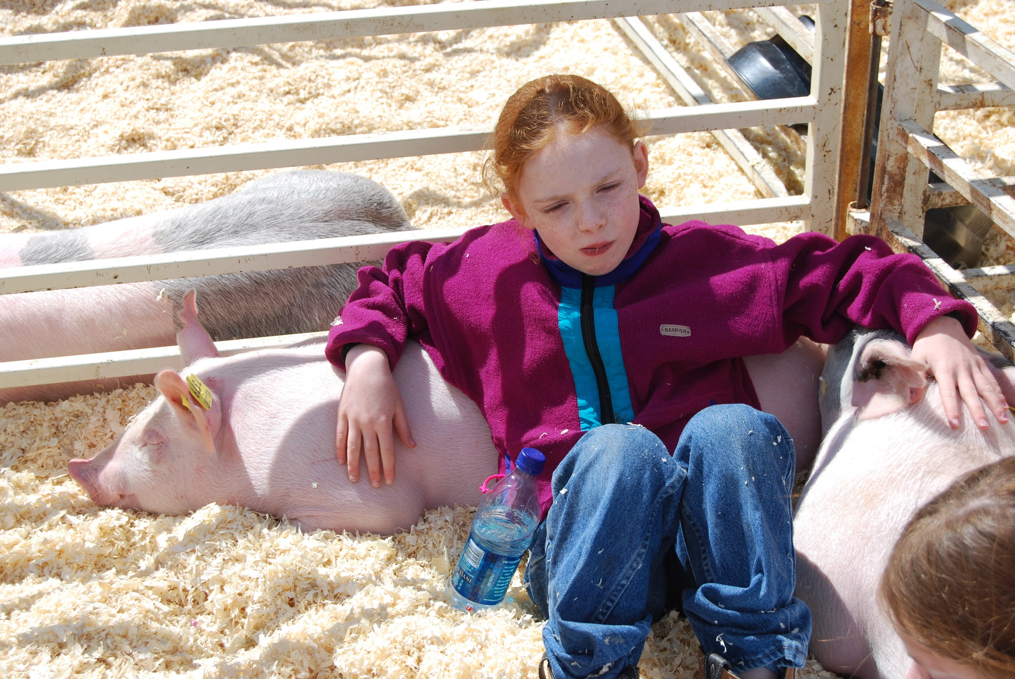
What are zoonoses?
Zoonoses (also known as zoonotic diseases):
Diseases that can be spread among animals and between animals and people
Notes:
(zoh-uh-noh-sis)
Photo Source: Renee Dewell, Iowa State University

Slide 6
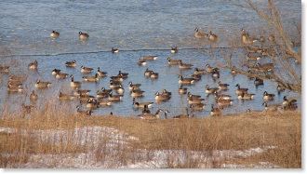
Endemic Disease
A disease regularly found among a particular population or in a certain area
This applies to zoonoses and non-zoonotic diseases

Slide 7
Endemic Disease
Avian Influenza
Also known as “bird flu”
Caused by infection with an influenza A virus
Endemic in some wild waterfowl populations, such as ducks and geese
Wild waterfowl are often asymptomatic but act as reservoirs for the disease
Infected wild waterfowl can serve as a source of the virus for domestic poultry if they are in the same areas
Notes:
Avian influenza, sometimes called “bird flu,” is caused by infection with influenza A viruses. Influenza viruses are endemic in some wild waterfowl populations, such as ducks and geese. Wild waterfowl are often asymptomatic (meaning that they do not show signs of illness) but can act as reservoirs for the virus. Reservoirs are animals that continuously have the disease-causing agent (but may not show signs) and can spread it to others. Infected waterfowl can serve as a source of the virus for domestic poultry, like chickens and turkeys, if they are in the same areas.

Slide 8
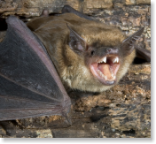
Endemic Disease
Rabies
Endemic in the U.S. and most of the world
In the U.S., primary reservoirs of the rabies virus are raccoons, skunks, and bats
Can infect all mammals, including people
Rabies is spread by the bite of an infected animal whose saliva contains the virus
Clinical signs in both animals and people include behavior changes, leg paralysis, drooling, and difficulty swallowing
Almost 100% infected die
A rabies vaccination is available for people and some types of animals
Notes:
Rabies virus is endemic in the United States and most of the world. In the United States, wildlife species such as raccoons, skunks, and bats are the primary reservoirs of the rabies virus. Rabies can infect all mammals, including humans. Rabies is spread by the bite of an infected animal whose saliva contains the virus. Clinical signs in both people and animals include behavior changes, leg paralysis, drooling, and difficulty swallowing. Rabies has a very high mortality (death) rate and almost 100% of cases result in death. A rabies vaccination is available for people and some types of animals.

Slide 9
Emerging Disease
A new disease that has appeared in a population for the first time, or that had previously existed but is rapidly increasing in incidence or geographic range (also known as re-emerging)
75% of emerging pathogens in humans are zoonotic diseases
Notes:
Incidence: The number of new cases
Pathogens: Disease-causing agents, such as viruses, bacteria, fungi, parasites, or prions

Slide 10
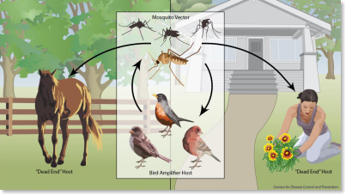
Emerging Disease
West Nile Virus
The virus appeared in the United States for the first time in 1999
Humans, exotic birds, crows, and horses can be infected with the virus
Birds are the primary reservoirs
West Nile virus is spread by the bite of infected mosquitoes
Humans and horses are dead-end hosts
West Nile is now endemic in North America
Notes:
West Nile appeared in the United States for the first time in 1999. There were 62 humans cases with 7 deaths. Exotic birds, crows, and horses were also infected. Birds are the primary reservoirs for West Nile virus. It is spread by the bite of infected mosquitoes. After feeding on infected birds, the mosquitoes can spread the virus to humans, horses, and other animals. Humans and horses are considered dead-end hosts. Dead-end hosts are hosts that cannot spread the virus to others. Since its emergence in the United States, the virus has become established here and continues to cause outbreaks in human and horse populations. West Nile is now endemic in North America.
Dead-end hosts: Hosts that cannot spread the virus to others

Slide 11
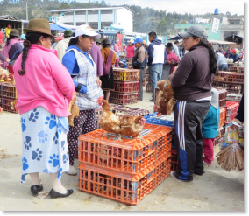
Emerging Disease
Avian Influenza H5N1
H5N1 re-emerged in Southeast Asia in 2003
Virus is classified as a highly pathogenic avian influenza (HPAI) virus
Over 100 million birds died or were culled
Over 800 cases of H5N1 influenza were reported in people as of early 2017
Notes:
H5N1 avian influenza virus re-emerged in Southeast Asia in 2003 after not being seen since 1997. H5N1 is classified as a highly pathogenic avian influenza (HPAI) virus, meaning that it often causes more severe disease and death in chickens than a low pathogenic avian influenza (LPAI) virus. Over 100 million birds died or were culled (removed from the flock or herd) and destroyed due to infection with H5N1. As of early 2017, there were over 800 cases of H5N1 influenza in people. About 50% of the human cases resulted in death.
Cull: Remove from the flock or herd

Slide 12
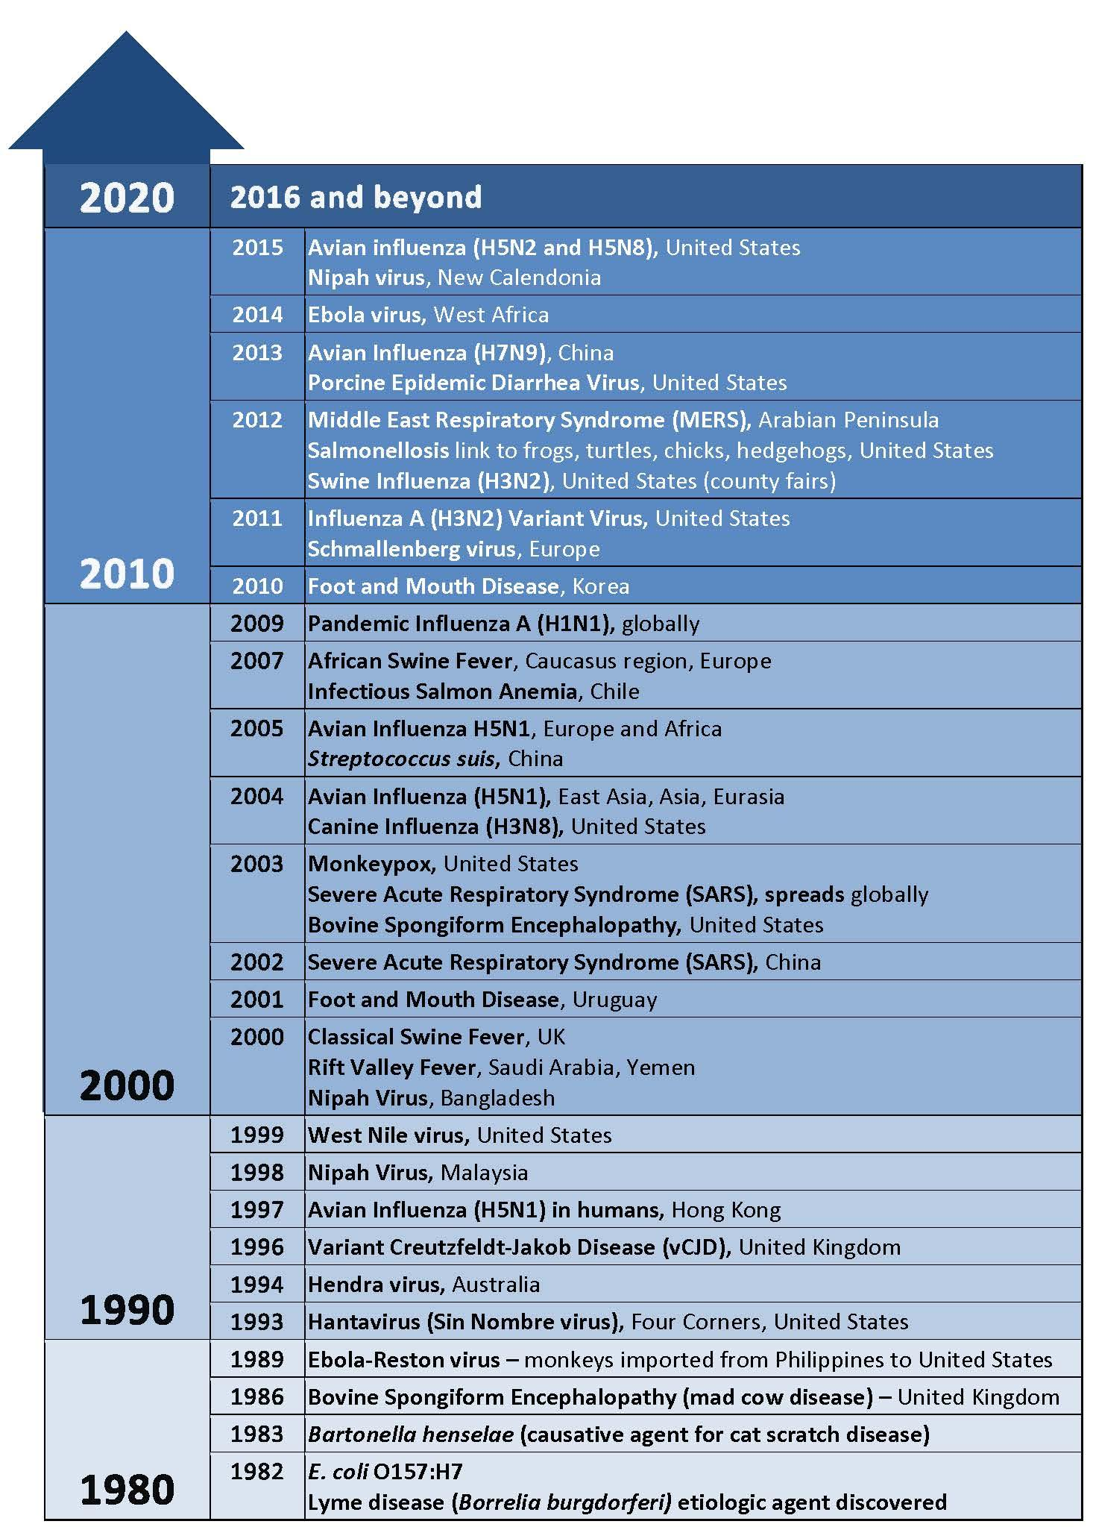
Recent Emerging Diseases
Notes:
Source: Center for Food Security and Public Health

Slide 13
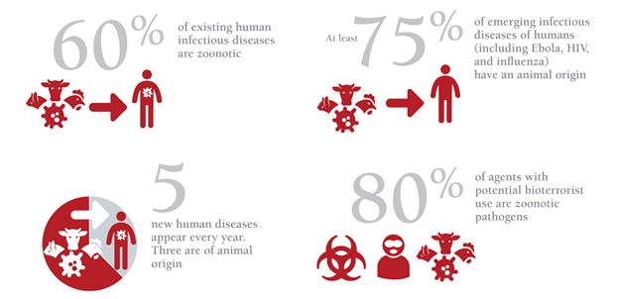
Emerging Zoonotic Diseases
www.oie.int/onehealth

Slide 14
Why Worry About Zoonoses?
Animal Health
Personal Health
Public Health
Food Safety

Slide 15
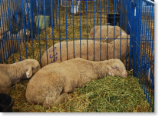
Animal Health
May appear healthy
Other clinical signs
Decreased weight gain
Poor performance
Decreased production
Severe disease
Do not take sick animals to a show or fair
Notes:
Animals with zoonotic infections may appear healthy on the outside. They might have decreased weight gain, poor performance, or decreased production (milk or eggs). Some animals will look like “poor doers.” Some zoonoses can even cause severe disease in animals. Preventive measures such as vaccinations and insect and other parasite control can help keep your animals healthy. These measures can also help limit the spread of disease from animals to humans. Animals suspected of having a disease should not be taken to any animal exhibition, such as a show or fair, and should be seen by a veterinarian.
Photo Source: Danelle Bickett-Weddle, Iowa State University

Slide 16
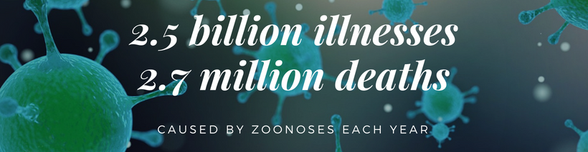
Personal Health
People who are in close contact with animals are at an increased risk of being infected with zoonotic diseases. Some people have an increased risk of developing severe complications if infected:
Children less than 5 years of age
Pregnant women
People older than 65 years
People with weakened immune systems
People with certain medical conditions
Notes:
Animals infected with zoonotic pathogens may become ill, but many will not become sick. Even if animals appear healthy, they can still spread pathogens to people. People who are in close contact with animals, such as pet owners and livestock producers, can be at an increased risk for zoonotic diseases. Children younger than 5 years old, pregnant women, people older than 65 years, people with weakened immune systems, and people with certain medical conditions are at an increased risk of developing serious complications of some diseases if they are infected. It is estimated that zoonoses are responsible for 2.5 billion cases of human illnesses and 2.7 million human deaths worldwide each year.

Slide 17
Public Health
Influenza viruses have the ability to cause severe disease in humans and animals
Zoonotic influenza: Influenza A viruses
Avian and swine origin
People in close contact with animals or living in crowed areas are more likely to be infected with influenza A viruses
People at a high risk for developing complications from influenza:
Children less than 5 years of age
Pregnant women
People older than 65 years
People with weakened immune systems
People with certain medical condition
Notes:
Some zoonoses can cause widespread and severe disease in humans and animals. One example is influenza. Influenza viruses can infect many animal species, including dogs, cats, horses, pet birds, poultry, and pigs. The virus can spread quickly through a population. Some influenza viruses are zoonotic. Zoonotic influenza that can infect people and animals during exhibitions is caused by an Influenza A virus. People who are in close contact with animals or who live in crowded areas are more likely to be infected with influenza A viruses. The zoonotic viruses of most zoonotic of most concern are influenza viruses of avian and swine origin. Certain groups of people are at a higher risk for developing complications from influenza. Those high risk groups of people include children less than 5 years of age, pregnant women, people older than 65 years, people with weakened immune systems, and people with certain medical conditions.

Slide 18
Public Health
Hemagglutinin (H)
Neuraminidase (N)
Notes:
Influenza A viruses are classified into groups, also known as subtypes, based on two surface proteins. One is called H (hemagglutinin) and the other is N (neuraminidase). These subtypes are used for naming viruses, e.g., H1N1. Different subtypes vary in their zoonotic risk and ability to cause disease.
Graphic illustration by: Center for Food Security and Public Health

Slide 19
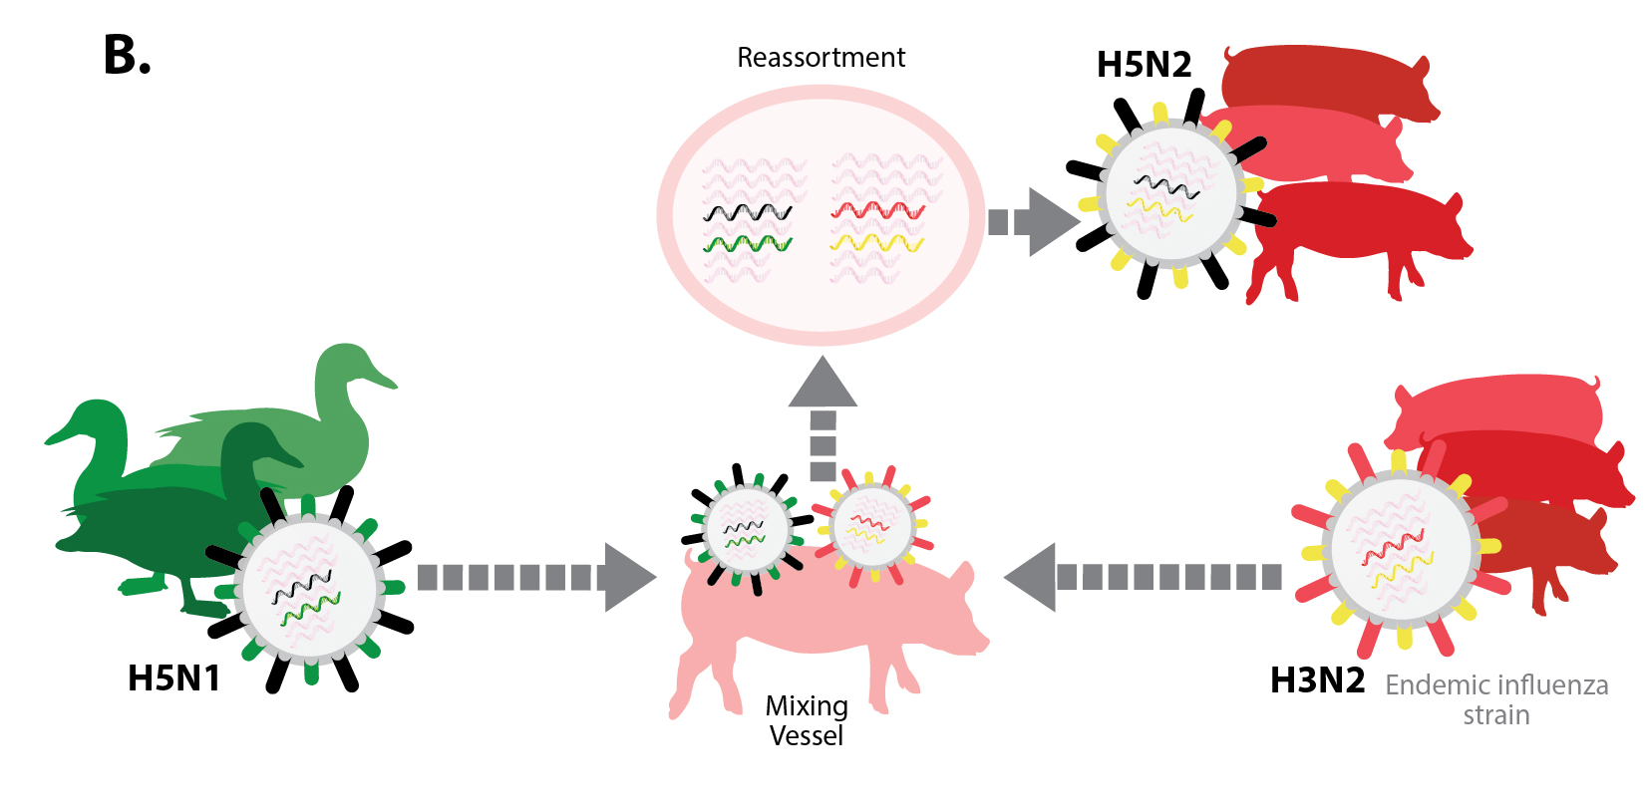
Public Health
Notes:
Influenza A viruses can undergo rapid genetic changes which then allow them to infect new species. When two different influenza viruses infect a single animal at the same time, the viruses can swap genetic information and create a new strain. This is called reassortment. The new virus will have some gene segments from each of the parent viruses.
Graphic illustration by: Center for Food Security and Public Health

Slide 20
Public Health
Example: Influenza Pandemics
1918 Spanish Influenza H1N1 Pandemic
1957–1958 Asian H2N2 Pandemic
1968–1969 Hong Kong H3N2 Pandemic
2009 H1N1 Pandemic
Notes:
A pandemic is a disease outbreak that occurs over a wide area and affects a large number of people.
1918 Spanish Influenza H1N1 Pandemic: It is estimated that 1/3 of the world’s population was infected with the H1N1 virus during this outbreak. About 50 million people died from influenza. The exact origin of the 1918 H1N1 virus is not known but it is thought that it was an avian-like virus that infected and adapted to humans.
1957–1958 Asian H2N2 Pandemic: The H2N2 virus responsible for this influenza pandemic had gene segments of both avian and human origin. The pandemic resulted in the death of almost 70,000 people in the United States and over 1 million people worldwide.
1968–1969 Hong Kong H3N2 Pandemic: The H3N2 influenza virus was also of both avian and human origin. This virus killed about 1 million people worldwide.
2009 H1N1 Pandemic: The 2009 H1N1 influenza virus was originally called swine flu. It is now known that the H1N1 virus contained gene segments from influenza viruses of swine, birds, and humans. H1N1 caused illness in over 200 countries and resulted in over 18,000 deaths. This virus is now considered a human virus that circulates seasonally. It is included in the annual flu vaccine.

Slide 21
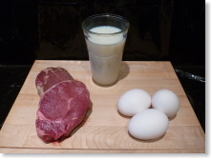
Food Safety
Foodborne pathogen: Disease-causing agent that is in or on the food we eat
Examples: Salmonella, Campylobacter, Listeria, E. coli
1 in 6 Americans will get sick from a foodborne illness each year
Contamination can occur anywhere along the food production chain
Notes:
Sometimes the food we eat can make us sick. Many zoonoses, such as Salmonella, Campylobacter, Listeria, and E. coli, are foodborne pathogens, meaning that the pathogen could be in or on the food that we eat. According to the CDC (Centers for Disease Control and Prevention), 1 in 6 Americans will get sick from a foodborne illness each year.
Contamination by foodborne pathogens can occur anywhere along the food production chain.

Slide 22
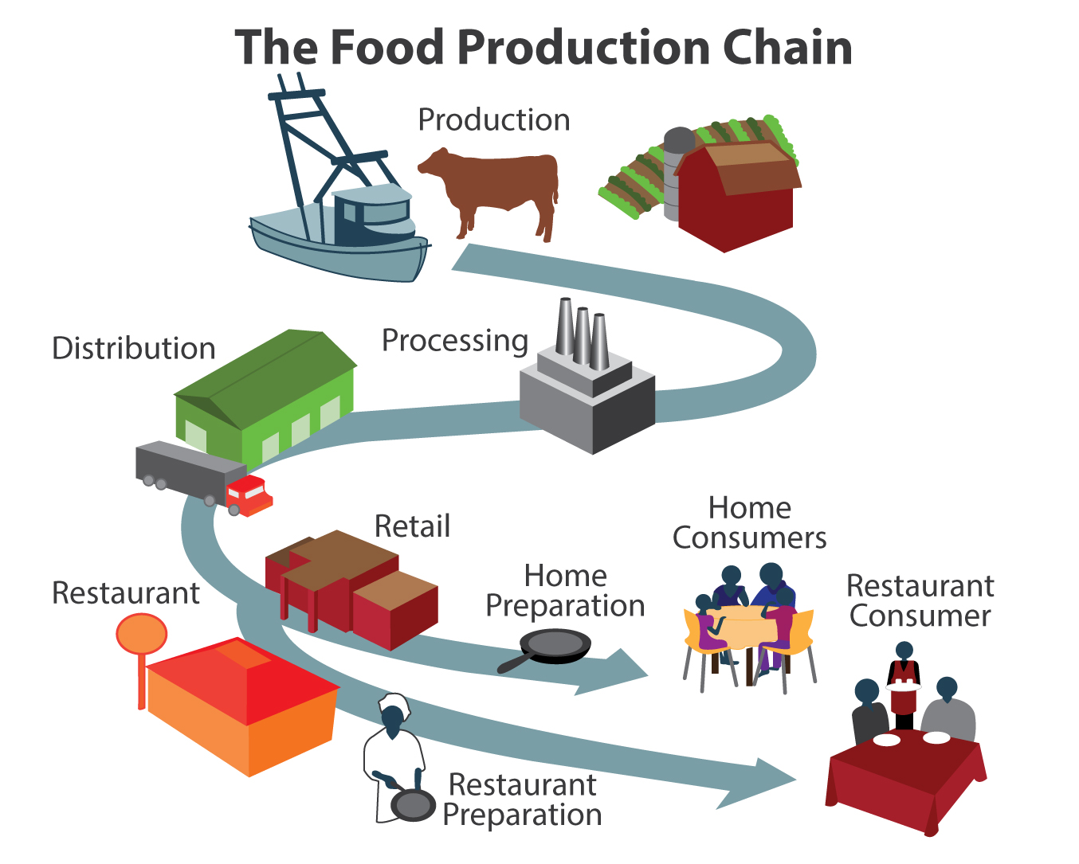
Food Safety
Notes:
Milk is an example of a food that can be contaminated by bacteria on the farm. There are several pathogens that can be present in raw milk, even if it comes from healthy animals. Illness can be prevented by pasteurizing milk. The pasteurization process uses heat to destroy bacteria, making the milk safe to drink.
If a sick animal enters the food supply, meat can become contaminated at the processing plant. USDA employees inspect animals for signs of disease at the plant to prevent any ill animals from entering the food supply.
Many foodborne illnesses are the result of improper food handling at home or in restaurants. Unclean hands, undercooked foods, and improper storage temperature can lead to foodborne illness.
Graphic illustration by: Center for Food Security and Public Health

Slide 23
Zoonoses Examples
Notes:
The next several slides give examples of common zoonoses that could infect you and your animal during exhibitions.

Slide 24
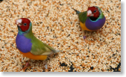
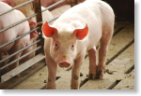
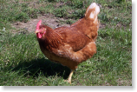
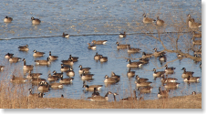
Avian Influenza
Cause: Influenza A virus
Also known as: Bird flu
Classified as highly pathogenic avian influenza (HPAI) or low pathogenic avian influenza (LPAI)
Reportable disease
Species commonly infected
Pet birds
Mammals
Poultry
Wild waterfowl
Notes:
Avian influenza, also known as bird flu, is caused by an Influenza A virus. Avian influenza viruses are classified based on the genetic characteristics of the virus and the severity of the disease in chickens. Viruses can be classified as highly pathogenic avian influenza (HPAI) or low pathogenic avian influenza (LPAI). Some strains of avian influenza are considered reportable. Reportable (or notifiable) diseases must be reported to local, state, or federal health officials when diagnosed or suspected. Diseases can be reportable in people, animals, or both. Species commonly infected by avian influenza viruses are pet birds, mammals, and poultry. Wild waterfowl are often carriers of the virus but do not show signs of disease.

Slide 25
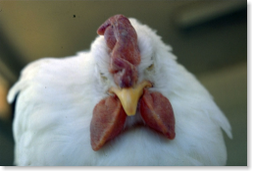
Avian Influenza
Clinical Signs in Domestic Poultry
Depression
Ruffled feathers
Lack of appetite
Watery diarrhea
Swollen combs and wattles
Decreased egg production
Paralysis
Sudden death

Slide 26
Avian Influenza
Clinical Signs and Symptoms in People
Fever
Aches
Pink-eye
Flu-like symptoms such as cough, sore throat, runny nose, headache, and tiredness
More severe disease is possible
Notes:
Not all strains of avian influenza are zoonotic. Humans can also be infected with avian influenza viruses. The people with the highest risk of getting avian influenza are those who come in close contact with infected birds. Person-to-person transmission is possible but rare. Clinical signs in humans include fever, aches, pink-eye, and other flu-like symptoms such as cough, sore throat, runny nose, headache, and tiredness. Avian influenza can cause severe disease in people as well.

Slide 27
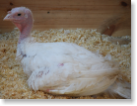
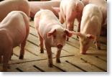
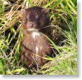
Influenza A Virus of Swine Origin
Cause: Influenza A virus
Also known as: IAV-S, or incorrectly called swine flu
Species commonly affected
Pigs
Turkeys
Mink
Ferrets

Slide 28
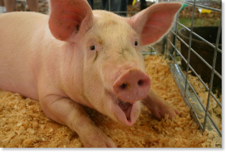
Influenza A Virus of Swine Origin
Clinical Signs in Pigs
Depression
Fever
Tiredness
Lack of appetite
Weight loss
Coughing
Sneezing
Nasal discharge
Labored breathing

Slide 29
Influenza viruses normally found in pigs are called “variant” viruses when they are found in people.
Influenza A Virus of Swine Origin
Clinical Signs and Symptoms in People
Flu-like symptoms
Fever
Cough
Sore throat
Runny nose
Muscle aches
Headache
Tiredness
Influenza viruses normally found in pigs are called “variant” viruses when they are found in people.
Notes:
Humans can become infected with IAV-S as well. Clinical signs in people include flu-like symptoms such as fever, cough, sore throat, runny nose, muscle aches, headache, and tiredness. Influenza viruses normally found in pigs are called “variant” viruses when they are found in people. Rare cases of severe disease in people due to variant viruses have been reported. Most human cases of IAV-S have involved people in close contact with infected pigs. Person-to-person transmission is possible but not common.

Slide 30
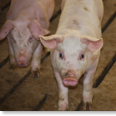
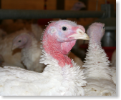
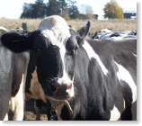
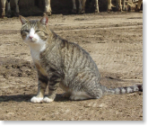
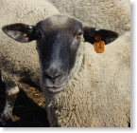
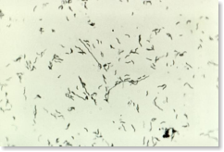
Campylobacteriosis
Cause: Campylobacter jejuni bacteria
Species commonly affected:
Poultry
Cats
Cattle
Dogs
Pigs
Sheep
Notes:
Cases of Campylobacteriosis in people may be reportable in some states. Report cases to your public health department.

Slide 31
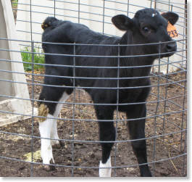
Campylobacteriosis
Clinical Signs in Animals
Diarrhea
Decreased appetite
Vomiting
Fever

Slide 32
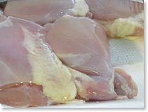
Campylobacteriosis
Clinical Signs and Symptoms in People
Diarrhea
Fever
Vomiting
Stomach pain
Headache
Muscle pains
Notes:
People can get campylobacteriosis from eating raw or undercooked meats or raw eggs or from drinking raw, unpasteurized milk. They can also get it from eating or drinking water contaminated with feces. It can be spread through direct contact with infected animals as well. People with campylobacteriosis may have diarrhea, fever, vomiting, stomach pain, headache, or muscle pains.

Slide 33
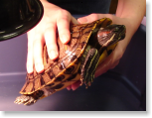
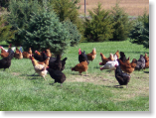
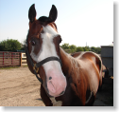
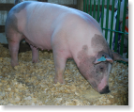
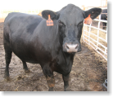
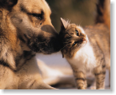
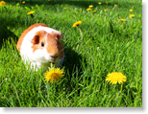
Salmonellosis
Cause: Salmonella bacteria
Species commonly affected:
Reptiles
Amphibians
Poultry
Horses
Pigs
Cattle
Sheep and goats
Dogs and cats
Small non-traditional pets such as guinea pigs and hedgehogs
Notes:
Cases of Salmonellosis in people may be reportable in some states. Report cases to your public health department.

Slide 34
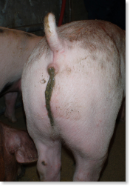
Salmonellosis
Clinical Signs in Animals
Animals are often asymptomatic
Diarrhea
Fever
Dehydration
Hunched position due to stomach pain
Notes:
Animals with salmonellosis often do not show clinical signs. If animals do show signs, the signs include diarrhea, fever, dehydration, and a hunched position due to stomach pain.

Slide 35
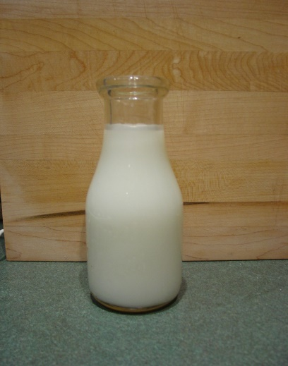
Salmonellosis
Clinical Signs and Symptoms in People
Diarrhea
Fever
Cramping
Notes:
Humans can get Salmonella through direct contact with feces from infected animals. They can also get it from eating improperly cooked food. Raw poultry, raw or undercooked eggs, and raw milk are common sources. Clinical signs in people include diarrhea, fever, and cramping.
Photo Sources: USDA (left), Danelle Bickett-Weddle, Iowa State University (right)

Slide 36
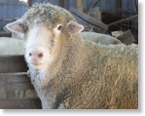
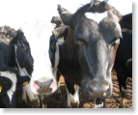
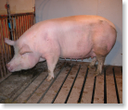
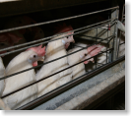
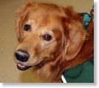
E. coli
Cause: Escherichia coli bacteria
Species commonly infected:
Goats
Sheep
Cattle
Pigs
Poultry
Dogs
Notes:
Cases of E. coli in people may be reportable in some states. Report cases to your public health department.

Slide 37
E. coli
Clinical Signs in Animals
Animals are carriers of the bacteria but might not become ill
Animals that do become ill will usually have diarrhea
In young pigs, E. coli can cause edema disease
Notes:
Animals are carriers of the bacteria but might not become ill. The most common clinical sign in animals that do become ill is diarrhea. E. coli can cause edema disease in young pigs. Pigs with edema disease will have swelling of the forehead, difficulty breathing, and a decreased appetite.

Slide 38
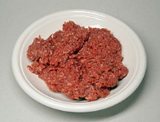
E. coli
Clinical Signs and Symptoms in People
Stomach pain
Cramping
Watery or bloody diarrhea
Hemolytic Uremic Syndrome is a serious kidney disease that sometimes follows an E. coli O157:H7 infection in people
Notes:
People can get E. coli from direct contact with feces from infected animals or from eating food that contains the bacteria. Raw or undercooked ground beef is a common source. Clinical signs in people include stomach pain, cramping, and watery or bloody diarrhea. Hemolytic Uremic Syndrome is a kidney disease that sometimes follows an E. coli O157:H7 infection in people. It is a life-threatening condition that most often affects children.
Photo Source: Rainer Zenz, https://commons.wikimedia.org/wiki/File:Hackfleisch-1.jpg

Slide 39
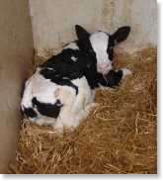
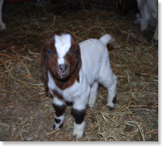
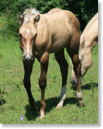
Cryptosporidiosis
Cause: Cryptosporidium parvum parasites
All mammals can be affected
More common in young animals
Notes:
Cases of Cryptosporidiosis in people may be reportable in some states. Report cases to your public health department.

Slide 40
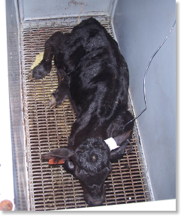
Cryptosporidiosis
Clinical Signs in Animals
Diarrhea
Poor appetite
Weight loss

Slide 41
Cryptosporidiosis
Clinical Signs and Symptoms in People
Watery diarrhea
Stomach cramps
Poor appetite
Notes:
Humans most often get cryptosporidiosis from eating food or drinking water that contains the parasite, or by contact with objects that have been contaminated by feces. This commonly happens during recreational water activities. Signs in humans are watery diarrhea, stomach cramps, and poor appetite.

Slide 42
Ringworm
Cause: Many species of fungi
Also known as: Dermatophytosis, club lamb fungus
Species commonly affected:
Dogs
Cats
Cattle
Goats
Horses
Pigs
Sheep

Slide 43
Ringworm
Clinical Signs in Animals
Hair loss
Scaling
Crusts
Redness
Notes:
Photo Source: Lucille K. Georg, CDC PHIL

Slide 44
Ringworm
Clinical Signs and Symptoms in People
Itchy skin
Ring-shaped rash
Red, scaly, cracked skin
Hair loss
Notes:
Photo Source: Grook Da Oger, https://commons.wikimedia.org/wiki/File:Herpes_circin%C3%A9_01.jpg

Slide 45
Contagious ecthyma
Cause: Contagious ecthyma virus
Also known as: Orf, Scabby Mouth, Sore Mouth, Contagious Pustular Dermatitis
Species commonly affected:
Goats
Sheep
Alpacas
Camels

Slide 46
Contagious ecthyma
Clinical Signs in Animals
Small raised bumps, sores, and blisters found on the lips, nose, ears, and eyelids
Notes:
Photo Source: James Nakano, CDC PHIL

Slide 47
Contagious ecthyma
Clinical Signs and Symptoms in People
One or more small, firm, red to blue bumps, sores, or blisters that last 3 to 6 weeks
Notes:
Photo Source: Centers for Disease Control and Prevention

Slide 48
Q fever
Cause: Coxiella burnetti bacteria
Reportable disease
Species commonly affected:
Cattle
Sheep
Goats
Notes:
Cases of Q fever in people may be reportable in some states. Report cases to your public health department.

Slide 49
Q fever
Clinical Signs in Animals
Spontaneous abortion
Infertility
Small offspring
Weak offspring
Notes:
Photo Source: Pam Zaabel, Iowa State University

Slide 50
Q fever
Clinical Signs and Symptoms in People
Fever
Chills
Night sweats
Headache
Weakness
Chest pains
Premature birth or miscarriage in pregnant women
Notes:
People usually get Q fever by breathing dust that contains the bacteria or by direct contact with infected animals. This commonly happens while helping animals give birth. Q fever in people may cause fever, chills, night sweats, headache, weakness, and chest pains. In pregnant women, it may cause premature birth or miscarriage.

Slide 51
Species Affected by Disease
 | Cats | Cattle | Dogs | Goats | Horses | Poultry | Sheep | Swine
Campylobacteriosis | ✓ | ✓ | ✓ |  |  | ✓ | ✓ | ✓
Contagious ecthyma |  |  |  | ✓ |  |  | ✓
Cryptosporidiosis | ✓ | ✓ | ✓ | ✓ | ✓ |  | ✓ | ✓
E. coli |  | ✓ | ✓ |  |  | ✓ | ✓ | ✓
Influenza A | ✓ |  | ✓ |  | ✓ | ✓ |  | ✓
Q fever | ✓ | ✓ | ✓ | ✓ | ✓ |  | ✓ | ✓
Ringworm | ✓ | ✓ | ✓ | ✓ | ✓ | ✓ | ✓ | ✓
Salmonellosis | ✓ | ✓ | ✓ | ✓ | ✓ | ✓ | ✓ | ✓

Slide 52
References
Centers for Disease Control and Prevention website. Healthy pets healthy people. Available at: https://www.cdc.gov/healthypets/. Accessed Feb 20, 2017.
Centers for Disease Control and Prevention website. Influenza. Available at: https://www.cdc.gov/flu/. Accessed Feb 20, 2017.
Center for Food Security and Public Health website. Available at: http://www.cfsph.iastate.edu. Accessed Nov 18, 2016.
Grace D, Mutua F, Ochungo P, et al. Mapping of poverty and likely zoonoses hotspots. Zoonoses Project 4. Report to the UK Department for International Development. Nairobi, Kenya: ILRI, 2012.

