Slide 1
This PowerPoint is a supplement to Lesson 2 of the Excellence in Exhibition: Preventing Disease in Animals and People course.
Notes:
Welcome to Excellence in Exhibition: Preventing Disease in Animals and People!
Animal agriculture is an important part of 4-H and FFA. Being a part of these organizations helps you gain knowledge about animals and develop responsibility, good sportsmanship, and confidence. However, there are many diseases that can be spread between people and animals, and knowing about these diseases is especially important because of the close contact that you have with your show animals.
This course was created to teach you how to keep yourself and your animals safe and healthy so that you can continue to enjoy showing and teaching others about animal agriculture.

Slide 2
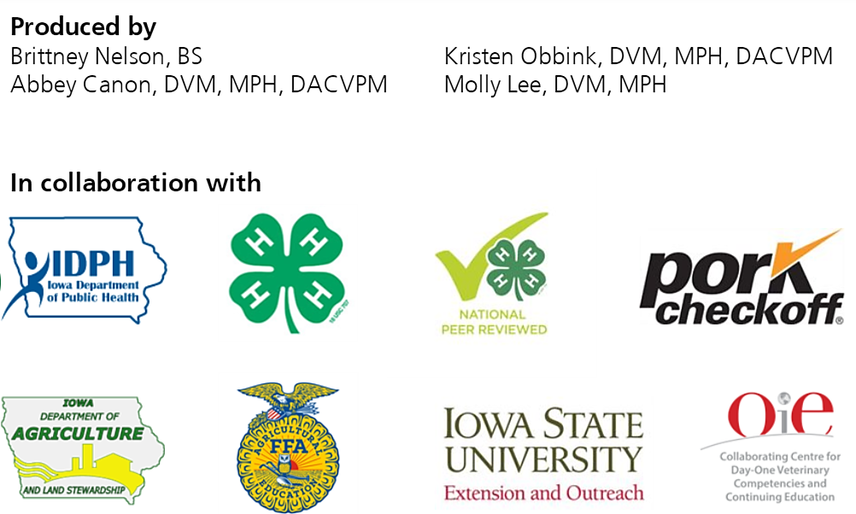
Acknowledgements
Iowa Department of Public Health receives funding for this project through a joint organizational partnership between the Council of State and Territorial Epidemiologists (CSTE) and the Centers for Disease Control and Prevention (CDC), provided by CSTE through sub-awards from the CDC cooperative agreement number: 5U38OT00143. The contents of this project are solely the responsibility of the authors and do not necessarily represent the official views of CDC or CSTE.
Notes:
Photos sources located in online version of lessons at www.bluenotflu.org

Slide 3
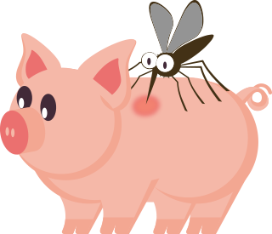
Zoonotic Disease Transmission
Notes:
This lesson will teach you about ways diseases can spread between animals and people. There are many factors that determine whether or not you will become ill. For example, simply touching an animal that is infected with a zoonotic disease does not mean you will become infected. However, understanding the ways disease can spread will help you know the best practices to stay healthy.

Slide 4
Learning Objectives
Explain the five routes of disease transmission.
Give an example of a zoonotic disease that can be transmitted by each route.
Describe how influenza viruses are transmitted among animals and to humans.
Explain ways to prevent each route of transmission.

Slide 5
Five Routes of
Disease Transmission
Direct Contact
Indirect Contact
Aerosol/Droplet
Ingestion/Oral
Vectors

Slide 6
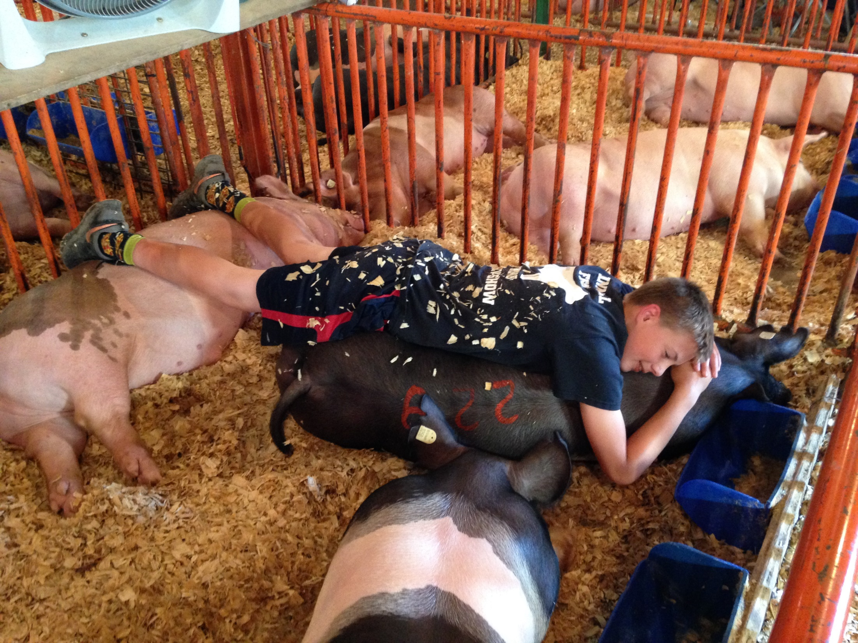
Direct Contact
Spread of pathogens through contact with an infected animal, its tissues, or its fluids by way of open wounds, mucous membranes (such as the lining of the digestive, respiratory, or urinary tracts), or scraped skin
Notes:
Direct contact transmission is the spread of pathogens through direct contact with an infected animal, its tissues, or its fluids (such as urine, feces, saliva, or blood) by way of open wounds, mucous membranes, or scraped skin. Influenza A virus of swine origin can be spread by direct contact. For example, a 4-Her might sleep in the pen with his four pigs during the fair. One of those pigs is infected with IAV-S. By the end of the fair, the 4-Her and two of the other pigs are also infected with influenza.
Photo Source: Tessa Klein, Iowa State University

Slide 7
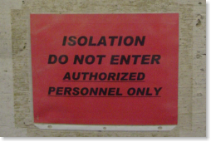
Ways to Prevent
Direct Contact Transmission
Isolate sick animals
Wear gloves when working with sick animals
Wash your hands after having contact with animals or being in animal areas even if you did not touch the animals

Slide 8
Disease | Direct Contact
Avian Influenza | ✓
Campylobacteriosis | ✓
Contagious ecthyma | ✓
Cryptosporidiosis | ✓
E. coli | ✓
Influenza A Virus of Swine Origin | ✓
Q fever | ✓
Ringworm | ✓
Salmonellosis | ✓

Slide 9
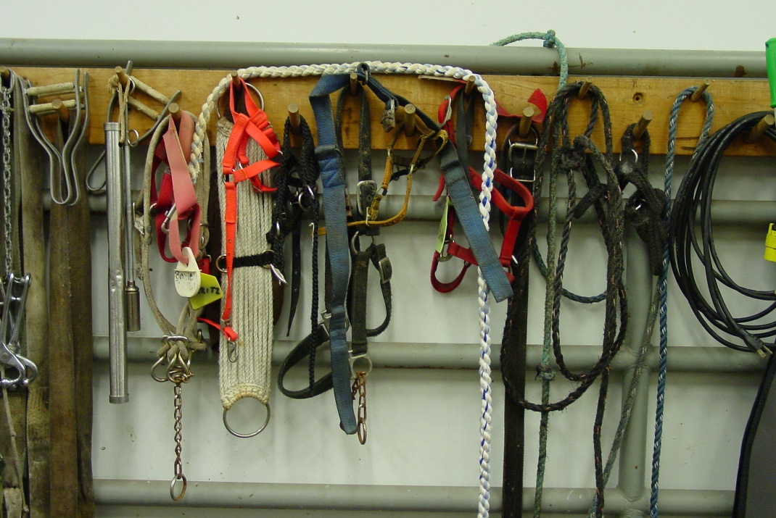
Indirect Contact
Spread of pathogens through coming into contact with areas where animals live and roam, or objects or surfaces contaminated by an infected animal
Fomites are objects or surfaces that may become contaminated with pathogens.
Notes:
Indirect contact transmission is the spread of pathogens through coming into contact with areas where animals live and roam, or objects or surfaces contaminated by an infected animal. Objects or surfaces that may become contaminated with pathogens are called fomites. Some examples of fomites are boots, cages, needles, bedding, clothing, vehicles, and restraint devices. Ringworm is one disease that can be spread by indirect contact. For example, a 4-H member borrows her friend's brush to groom her horse. The horse that the brush is usually used on is infected with ringworm and ringworm is also present on the brush. As a result the 4-H member borrowing the brush also becomes infected with ringworm.
Photo Source: Danelle Bickett-Weddle, Iowa State University

Slide 10
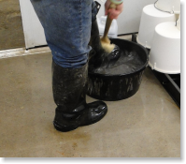
Ways to Prevent
Indirect Contact Transmission
Avoid sharing equipment, or clean and disinfect equipment when sharing is necessary
Clean and disinfect any equipment used with sick animals or animals with skin lesions
Dispose of or wash boots and clothing after animal contact
Wash your hands after having contact with animals or being in animal areas even if you did not touch the animals

Slide 11
Disease | Direct Contact | Indirect Contact
Avian Influenza | ✓ | ✓
Campylobacteriosis | ✓
Contagious ecthyma | ✓ | ✓
Cryptosporidiosis | ✓
E. coli | ✓
Influenza A Virus of Swine Origin | ✓ | ✓
Q fever | ✓
Ringworm | ✓ | ✓
Salmonellosis | ✓

Slide 12
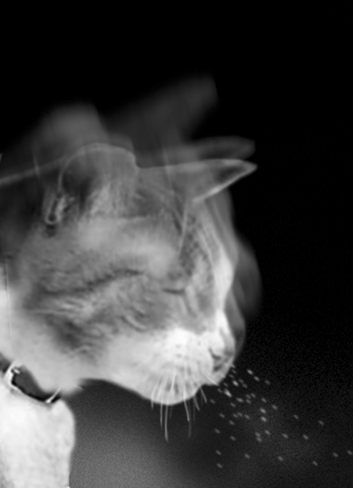
Aerosol/Droplet
Droplets containing pathogens travel through the air and are inhaled by another animal or human
Notes:
Aerosol/droplet transmission occurs when droplets containing pathogens travel through the air and are inhaled by another animal or human. Avian influenza is one disease spread by aerosol. One way this could happen is if there is a turkey infected with avian influenza that is sneezing. Nearby turkeys and humans that inhale the droplets in the air could then become infected with avian influenza as well.
Photo Source: Clint May, Iowa State University

Slide 13
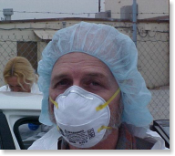
Ways to Prevent
Aerosol/Droplet Transmission
Increase distance between sick animals and healthy animals and people
Wear respiratory protection when working with sick animals
Provide fresh air to animals and people
Decrease humidity and odor build up in barns
Sick people should stay away from animal barns

Slide 14
Disease | Direct Contact | Indirect Contact | Aerosol/ Droplet
Avian Influenza | ✓ | ✓ | ✓
Campylobacteriosis | ✓
Contagious ecthyma | ✓ | ✓
Cryptosporidiosis | ✓
E. coli | ✓
Influenza A Virus of Swine Origin | ✓ | ✓ | ✓
Q fever | ✓ |  | ✓
Ringworm | ✓ | ✓
Salmonellosis | ✓

Slide 15
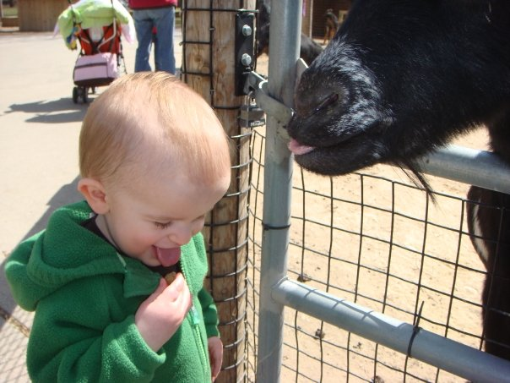
Ingestion/Oral
Ingestion of disease-causing agents from contaminated food or water or by licking or chewing contaminated objects in the environment
Notes:
Ingestion, or oral, transmission occurs when disease-causing agents are ingested from contaminated food or water or by licking or chewing contaminated objects in the environment. Cryptosporidiosis is an example of a disease that can be spread by ingestion. An infected calf might shed the Cryptosporidium parvum parasite in its feces. A person is then infected after cleaning the calf’s pen and not washing their hands before eating.
Photo Source: Angela Anderson, South Dakota

Slide 16
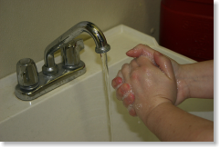
Ways to Prevent
Oral Transmission
Wash your hands
After contact with animals or being in animal areas, even if you did not touch the animals
After cleaning pens or contact with manure
Before preparing or handling food
After going to the bathroom
Cook meat to the appropriate temperature
Store food at the proper temperature

Slide 17
Disease | Direct Contact | Indirect Contact | Aerosol/ Droplet | Ingestion/Oral
Avian Influenza | ✓ | ✓ | ✓
Campylobacteriosis | ✓ |  |  | ✓
Contagious ecthyma | ✓ | ✓
Cryptosporidiosis | ✓ |  |  | ✓
E. coli | ✓ |  |  | ✓
Influenza A Virus of Swine Origin | ✓ | ✓ | ✓
Q fever | ✓ |  | ✓ | ✓
Ringworm | ✓ | ✓
Salmonellosis | ✓ |  |  | ✓

Slide 18
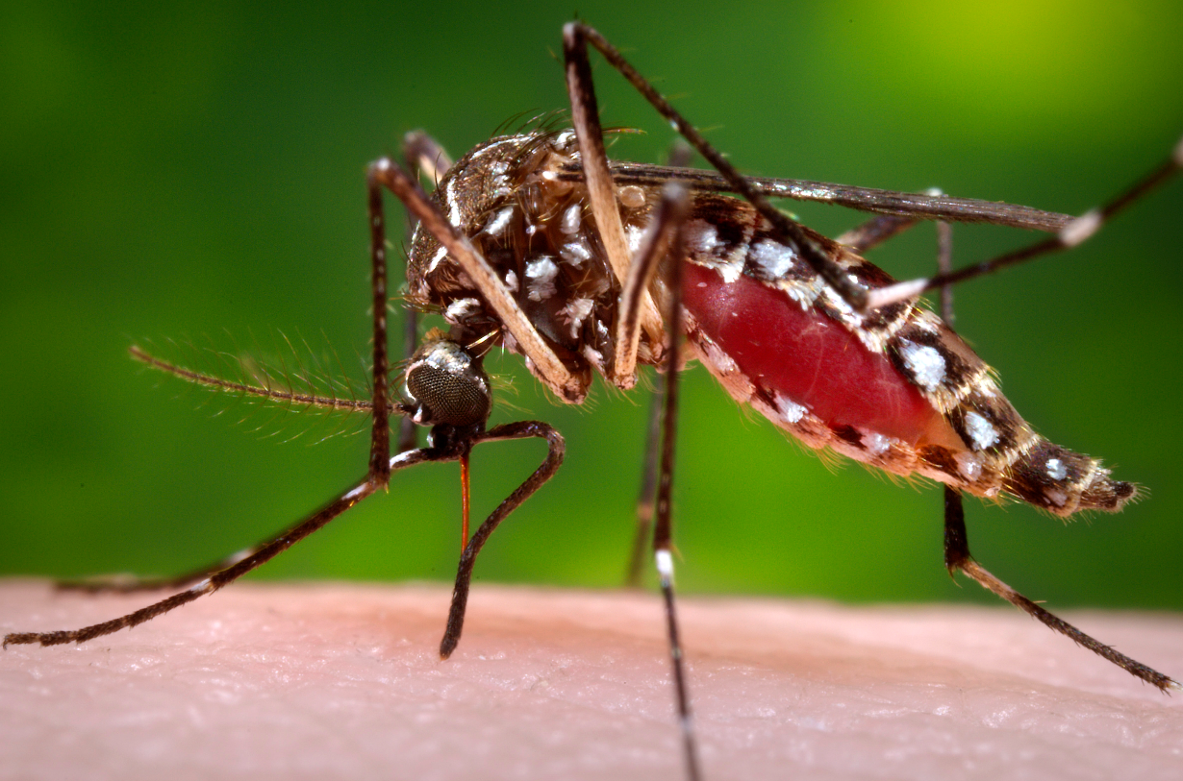
Vectors
Transfer of a pathogen from an infected animal to another animal or a human by an arthropod
Notes:
Vector transmission occurs when a pathogen is transferred from an infected animal to another animal or human by an arthropod. West Nile virus is spread by vectors. Mosquitoes that bite birds (the reservoir host for the virus) can then feed on humans and transfer the virus to them.
Photo Source: CDC Public Health Image Library

Slide 19
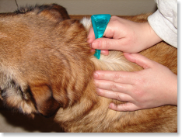
Ways to Prevent
Vectorborne Transmission
Use insect control products
Work with your veterinarian to check and treat your animals for parasites
Prevent standing water regularly
Check for ticks on people and pets

Slide 20
Disease | Direct Contact | Indirect Contact | Aerosol/ Droplet | Ingestion/Oral | Vectors
Avian Influenza | ✓ | ✓ | ✓
Campylobacteriosis | ✓ |  |  | ✓
Contagious ecthyma | ✓ | ✓
Cryptosporidiosis | ✓ |  |  | ✓
E. coli | ✓ |  |  | ✓
Influenza A Virus of Swine Origin | ✓ | ✓ | ✓
Q fever | ✓ |  | ✓ | ✓ | ✓
Ringworm | ✓ | ✓
Salmonellosis | ✓ |  |  | ✓

Slide 21
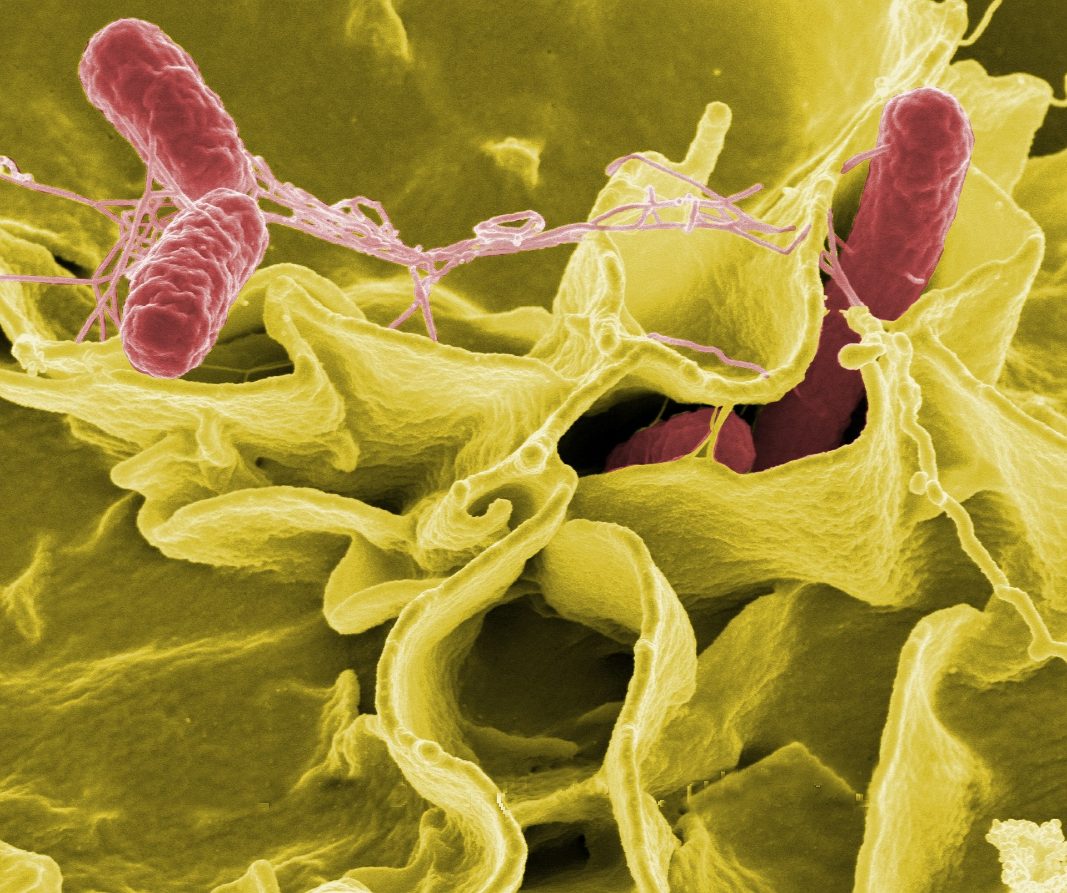
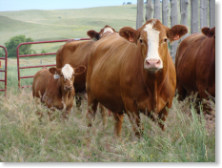
Epidemiologic Triangle
Agent
The cause of the disease
Environment
The surroundings and conditions outside of the host that cause or allow the disease to be transmitted
Host
The animal or human that is exposed to and carries the disease
Notes:
The epidemiological triangle is used to study infectious diseases and how they spread. For an animal or human to be infected with a specific pathogen, all three corners of the triangle must favor the spread of disease.
The agent is the cause of the disease. Disease-causing agents can be viruses, bacteria, fungi, parasites, or prions.
The host is the animal or human that is exposed to and carries the agent. Hosts may or may not show signs of illness.
The environment is the surroundings and conditions outside of the host that cause or allow the agent to be transmitted.

Slide 22
References
Center for Food Security and Public Health website. Available at: http://www.cfsph.iastate.edu. Accessed Nov 18, 2016.

