Slide 1
This PowerPoint is a supplement to Lesson 3 of the Excellence in Exhibition: Preventing Disease in Animals and People course.
Notes:
Welcome to Excellence in Exhibition: Preventing Disease in Animals and People!
Animal agriculture is an important part of 4-H and FFA. Being a part of these organizations helps you gain knowledge about animals and develop responsibility, good sportsmanship, and confidence. However, there are many diseases that can be spread between people and animals, and knowing about these diseases is especially important because of the close contact that you have with your show animals.
This course was created to teach you how to keep yourself and your animals safe and healthy so that you can continue to enjoy showing and teaching others about animal agriculture.

Slide 2
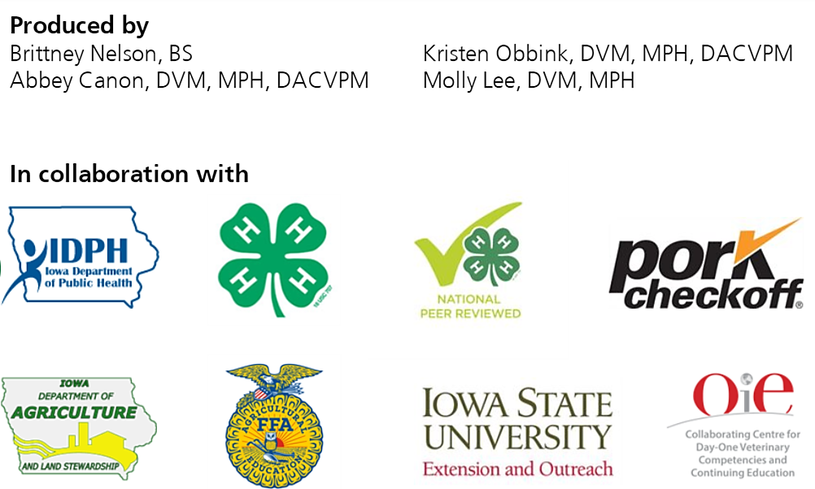
Acknowledgements
Iowa Department of Public Health receives funding for this project through a joint organizational partnership between the Council of State and Territorial Epidemiologists (CSTE) and the Centers for Disease Control and Prevention (CDC), provided by CSTE through sub-awards from the CDC cooperative agreement number: 5U38OT00143. The contents of this project are solely the responsibility of the authors and do not necessarily represent the official views of CDC or CSTE.
Notes:
Photos sources located in online version of lessons at www.bluenotflu.org

Slide 3
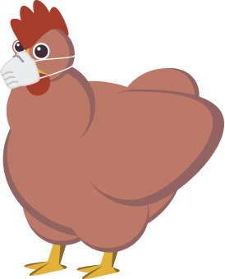
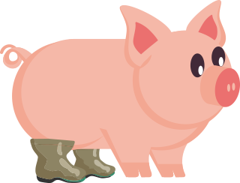
Zoonotic Disease Prevention and Biosecurity
Notes:
You’ve now learned about the different ways that diseases can be spread. Lesson 3 will teach you about ways to prevent disease spread on your farm and at exhibitions. Working with and showing your animals is a fun and rewarding experience. By practicing the prevention measures you will learn about in this lesson, you can make sure that both you and your animals stay healthy.

Slide 4
Learning Objectives
Define biosecurity.
Explain the importance of biosecurity in zoonotic disease control.
Review ways zoonotic diseases might be spread to you, your family, and your animals on the farm and at exhibitions.
Describe measures to prevent zoonotic disease spread to you, your family, and your animals on farms and at exhibitions.

Slide 5
Biosecurity Basics
Biosecurity is a series of practices designed to prevent the introduction and spread of pathogens.
Good biosecurity can help keep you and your animals healthy.

Slide 6
Biosecurity Basics
Keep disease from entering an area
Prevent disease from spreading to other locations

Slide 7
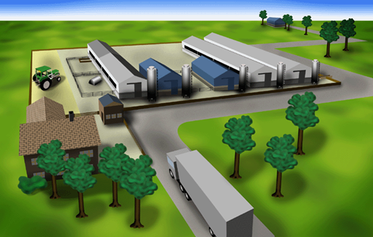
Ways Pathogens
Can Enter a Farm
Feed and water
Farm animals
Equipment and bedding
Air
Birds,
insects, rodents, and other wild animals
People
Vehicles
Notes:
Source: Locke Karriker, ISU VDPAM

Slide 8
Biosecurity on the Farm

Slide 9
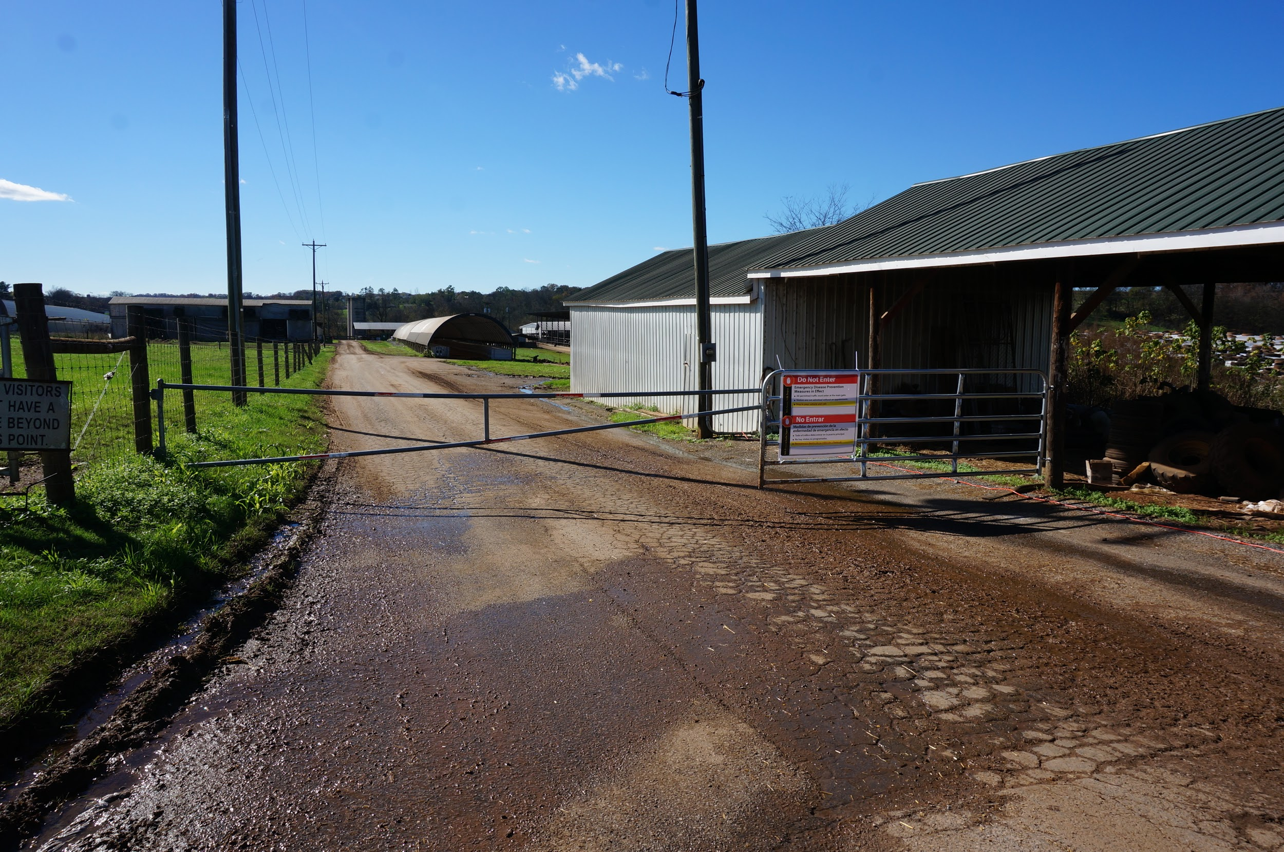
Farm Entrance and Perimeter
Limit access to the farm
Minimize visitors and traffic
Have only one gated entrance to the animal areas
Lock gates to prevent unwanted entry
Maintain fences to keep your animals in and other animals out
Notes:
Photo Source: Danelle Bickett-Weddle, Iowa State University

Slide 10
Farm Entrance and Perimeter
Limit contact between your animals and outside animals including:
Neighbors’ livestock
Rodents, wildlife, and other animals
Birds
Dogs, cats, and other pets that are free to roam
Post signs at the farm entrance to inform visitors of biosecurity procedures to follow

Slide 11
People and Vehicles
Keep a record of visitors who enter and leave your farm
Require that all people wash hands before and after animal contact and after leaving animal areas even if they did not touch animals
Require that employees who have contact with outside livestock use the same biosecurity measures as visitors
Be able to recognize and report diseases
Prevent off-farm vehicles from driving where animals are kept

Slide 12
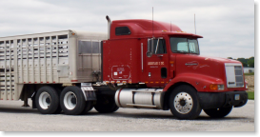
People and Vehicles
Make sure visitors avoid livestock areas and do not contact animals
Take steps to prevent disease spread between your neighbors’ farm and yours
Do not share equipment or vehicles between farms
If equipment must be shared, all manure and bedding should be removed. Then the equipment should be cleaned, rinsed, disinfected, and then rinsed again before using it with your animals

Slide 13
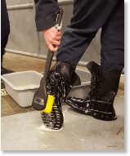
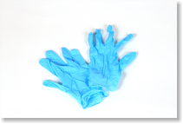
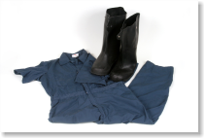
Personal Protective Equipment (PPE)
Wear gloves when working with animals
Wear clean boots or disposable boot covers in animal areas
Have a boot bath or trash at entrances and exits
Clean the boot bath regularly
Wear clean protective outer clothing when working with animals

Slide 14
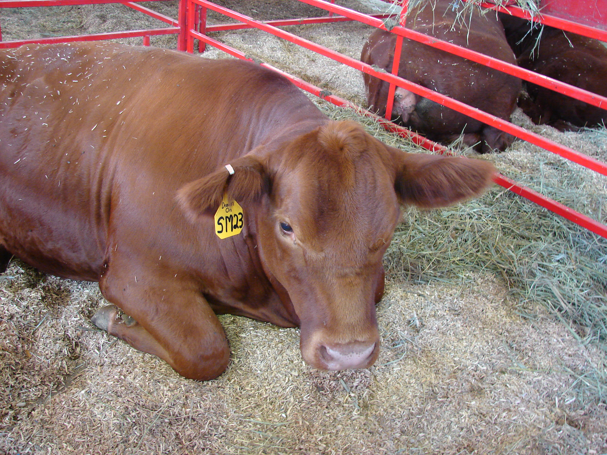
Farm Animals
ID animals individually
Maintain health records for every animal and records of animal movement
Inspect animals for signs of illness at least daily
Review vaccination and preventive care with your veterinarian yearly
Use separate facilities and equipment to handle sick animals

Slide 15
Farm Animals
Visit sick animals last when working with groups of animals
Clean equipment and boots and change clothing between groups of different health statuses
Quarantine all new or reintroduced animals to prevent exposing your herd or flock to different pathogens
Isolate sick animals immediately to minimize disease exposure of others in the herd or flock
Remove dead animals quickly and dispose of carcasses in a safe manner that prevents wildlife and rodent attraction

Slide 16
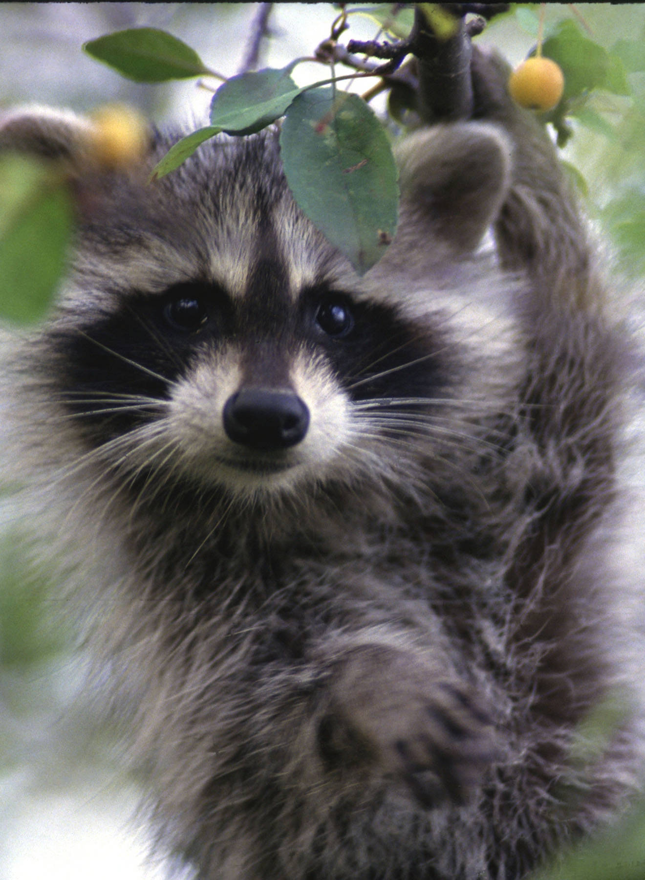
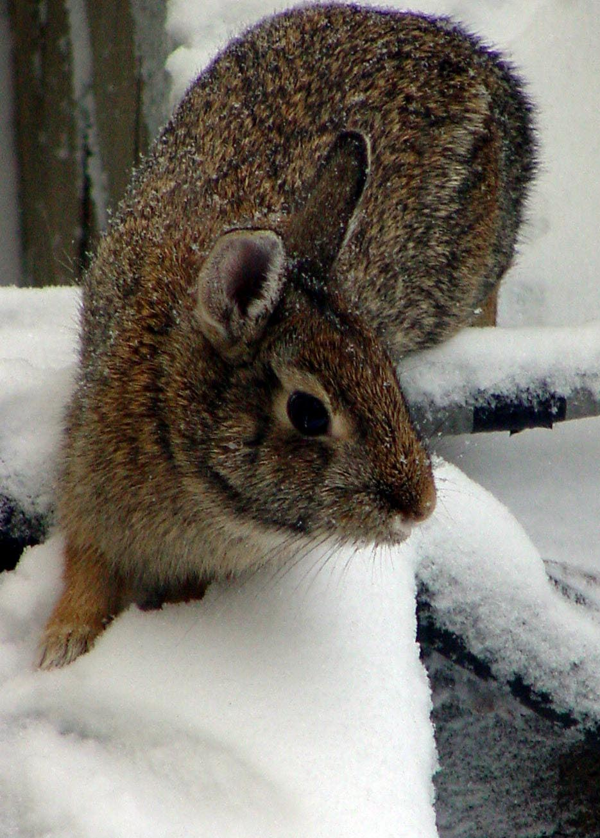
Wildlife and Other Animals
Prevent contact with free roaming animals
Control wildlife access to the farm
Minimize bird contact and nesting on your farm
Have a rodent control program
Secure all feed storage areas and clean up spilled feed to minimize access by pests
Notes:
Photo Sources: USFWS (left) and Clint May, Iowa State University (right)

Slide 17
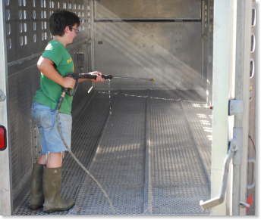
Cleaning and Disinfection
Step 1: Cleaning
Remove all organic material (e.g., manure, dirt, feed, debris)
Wash
Rinse
Allow to dry
Step 2: Disinfection
Follow the label instructions on the disinfectant
Apply the disinfectant for the proper contact time
Rinse

Slide 18
Human Health on Farms
Notes:
People who live or work on farms with animals are at risk of infection with zoonotic diseases. Many of the biosecurity practices listed earlier not only protect animal health but also prevent the spread of zoonoses to humans. There are other measures that can be taken to prevent disease spread to humans as well.

Slide 19
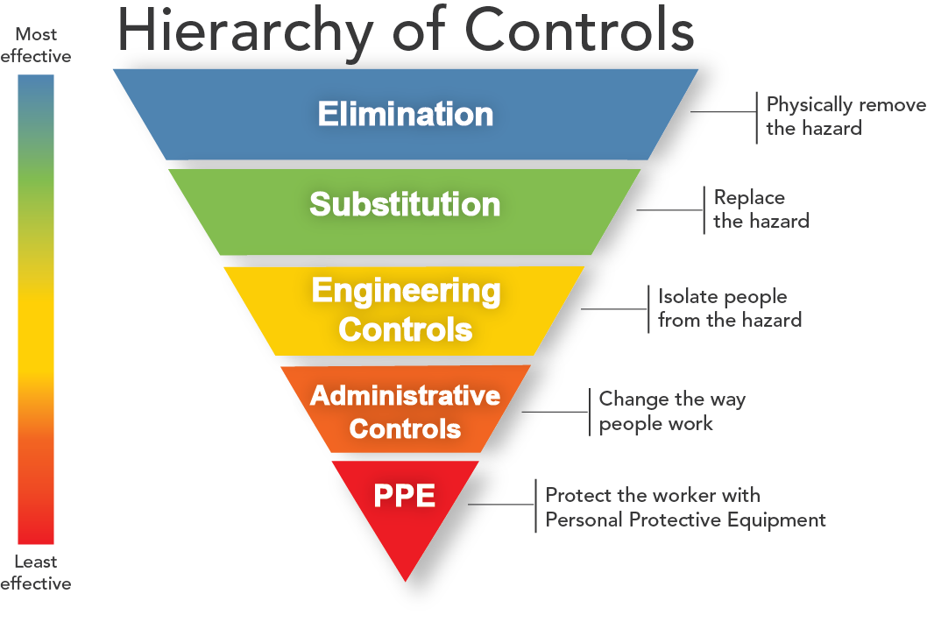
NIOSH Hierarchy of Controls
Notes:
The NIOSH (National Institute for Occupational Safety and Health) Hierarchy of Controls is a system that can be used to reduce or eliminate exposures to hazards. Actions at the top are the most effective methods and actions at the bottom are the least effective.
Elimination means to physically remove the hazard.
Substitution is to replace the hazard. Elimination and substitution are often not options when zoonoses are the hazard.
Engineering controls means to isolate people from the hazard. Examples of engineering controls could be to put sick animals in isolation and to restrict the number of people who have contact with sick animals.
Administrative controls deals with changing the way people work. Examples of administrative controls relating to zoonoses are: do not eat or drink in animal areas, wash your hands after contact with animals, and cover any open wounds when working with animals.
PPE means to protect the worker with personal protective equipment. Gloves, protective outerwear, and respiratory protection are examples of PPE.
Source: https://www.cdc.gov/niosh/topics/hierarchy/

Slide 20
Biosecurity at Exhibitions

Slide 21
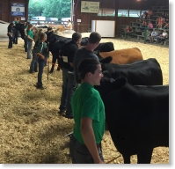
Biosecurity at Exhibitions
Work with your veterinarian to ensure that your animals receive the appropriate preventive care before exhibitions
Vaccinations
Parasite control
Only bring healthy animals to public settings
If your animal becomes sick, remove them from areas of human contact and contact your veterinarian

Slide 22
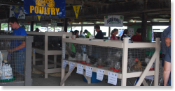
Biosecurity at Exhibitions
Visitors to animal exhibitions should be informed that the following groups of people are at an increased risk of developing severe complications:
Children less than 5 years of age
Pregnant women
People 65 years and older
People with weakened immune systems
People with certain medical conditions

Slide 23
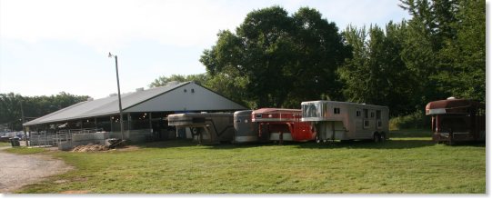
Biosecurity at Exhibitions
Exhibition facilities should have specific non-animal areas, transition areas, and animal areas.

Slide 24
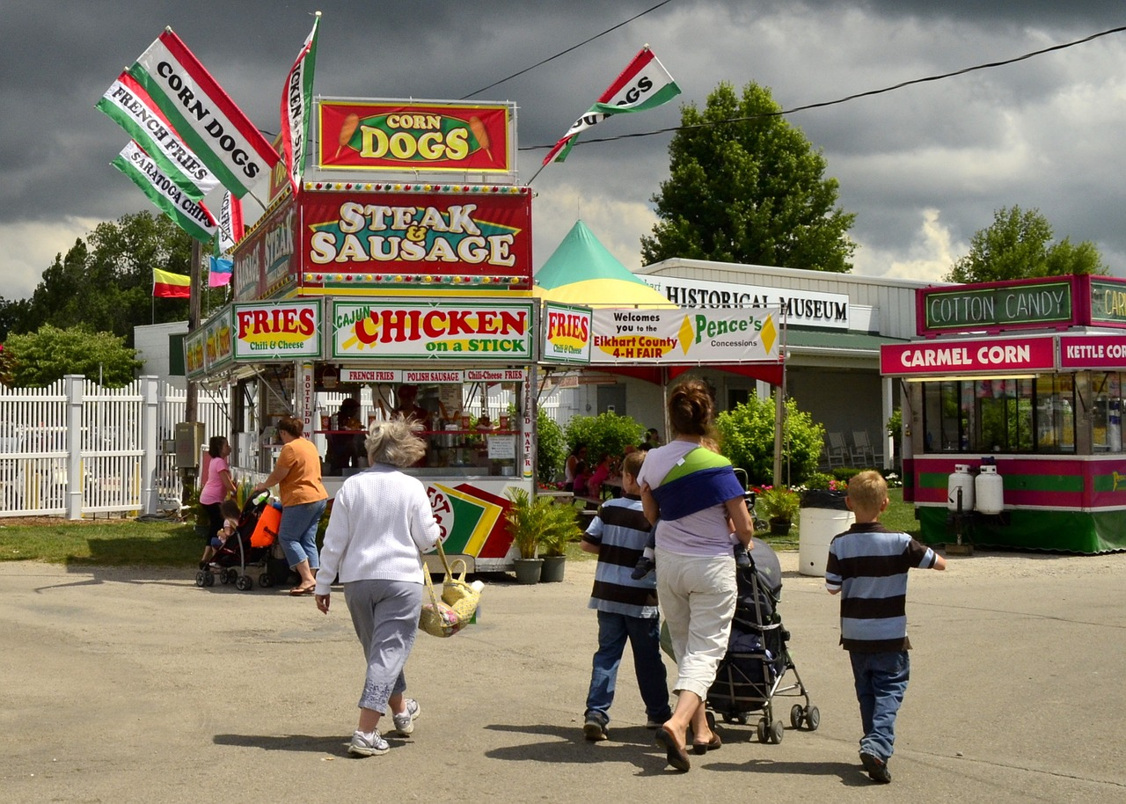
Non-Animal Areas
Notes:
Non-animal areas are areas where visitors have no contact with animals. Food and beverages can be allowed in these areas. Hand washing stations should be available and accessible to all visitors.
Photo Source: https://pixabay.com/en/elkhart-indiana-in-county-fair-732474/

Slide 25
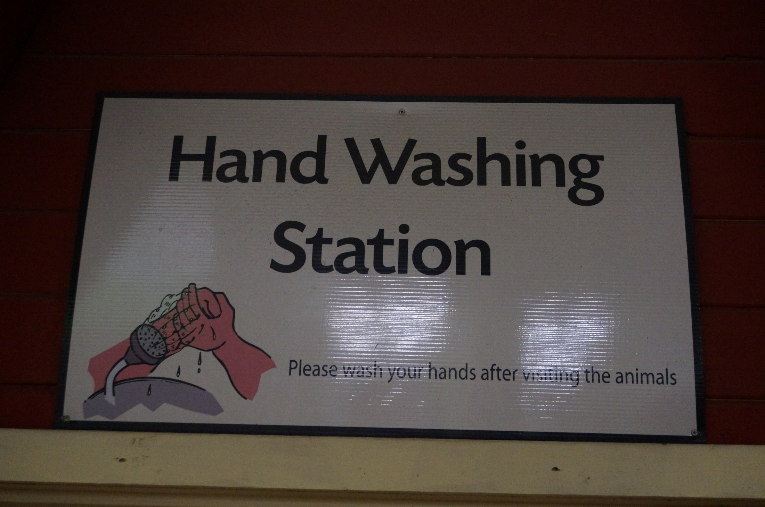
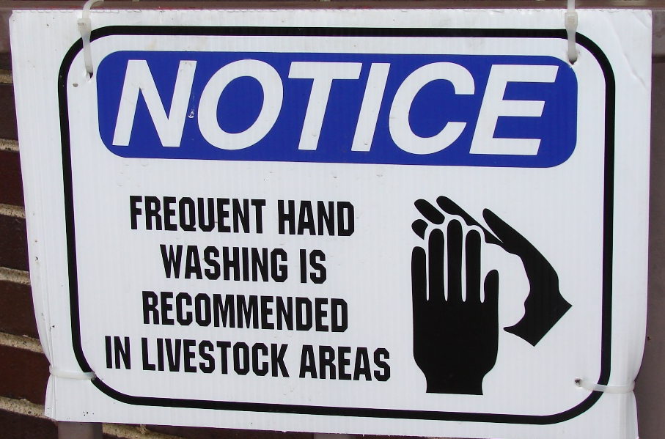
Transition Areas
Notes:
Transition areas are those located between animal and non-animal areas. Signs should be posted telling visitors that they are about to enter an animal area and that things like food, strollers, and toys are not allowed in the animal area. The signs should notify visitors of the risks associated with animal contact. They should also tell visitors to wash their hands when leaving the animal area. The signs should show the correct hand washing procedure and should be made available in multiple languages if necessary. Hand washing stations should be available in transition areas.
Photo Sources: Danelle Bickett-Weddle, Iowa State University (both)

Slide 26
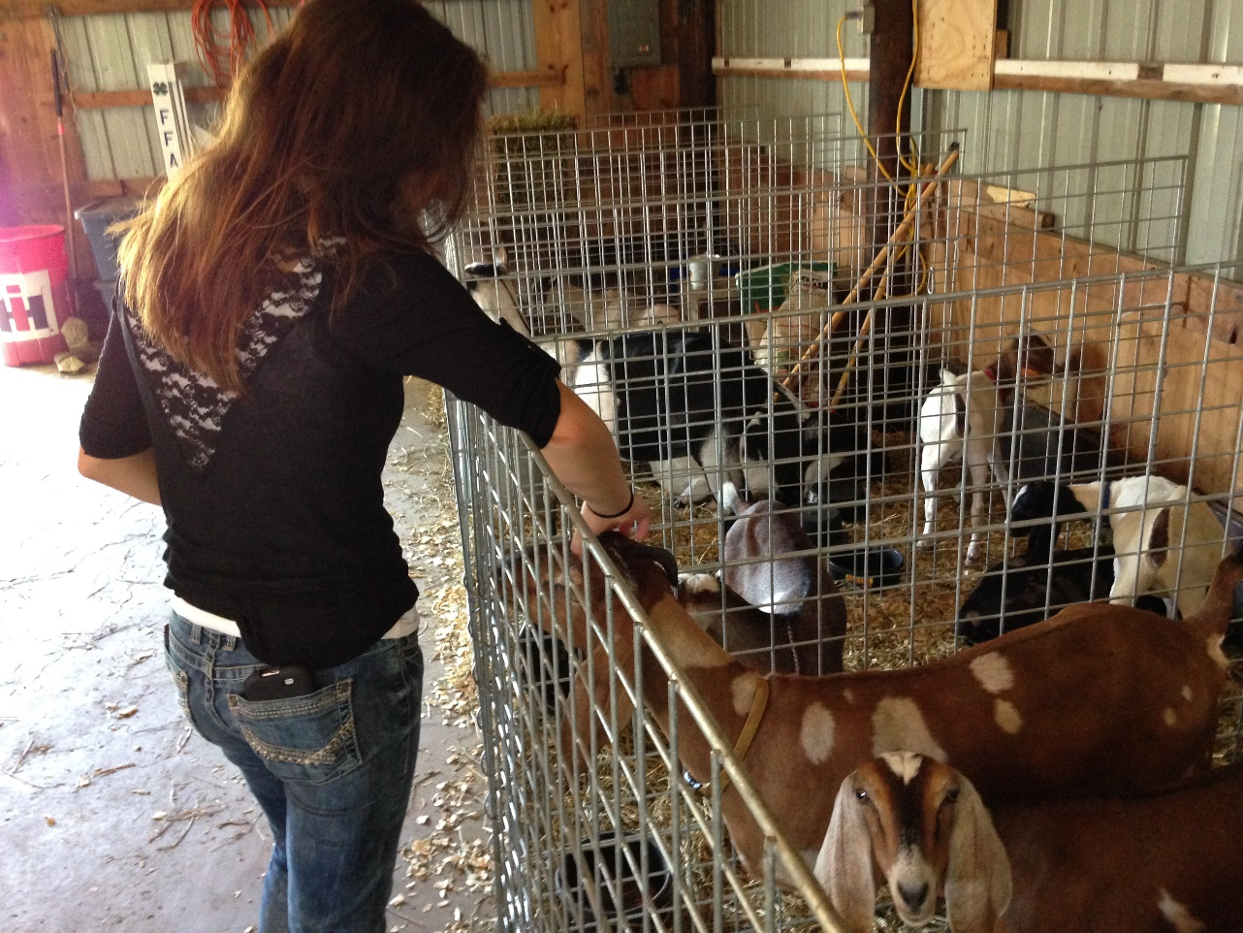
Animal Areas
Notes:
Animal areas are areas where people may have animal contact. Manure and soiled bedding should be promptly removed from these areas. The public should not have direct contact with manure or dirty surfaces. Feed should be covered and stored in sealed containers. There should be no strollers, toys, etc. brought into an animal area. You should avoid eating, drinking, and sleeping in these areas. After the animals leave, the area needs to be cleaned and disinfected.
Photo Source: Tessa Klein, Iowa State University

Slide 27
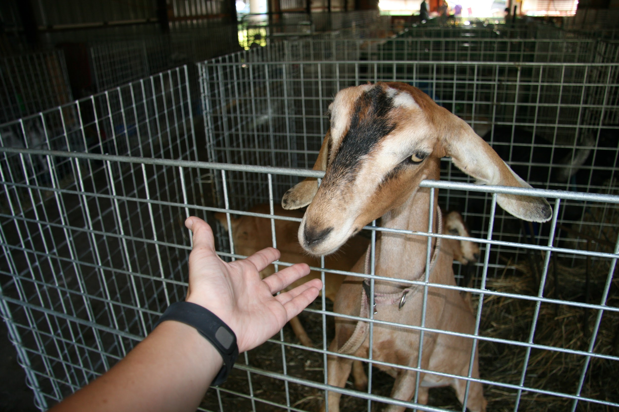
Animal Health at an Exhibition
Avoid mixing of animals from different farms
Do not share equipment with other exhibitors
Keep visitors from touching animals
Remove manure and clean pens often
Observe animals regularly for signs of illness
Notes:
Photo Source: Brittney Nelson, Iowa State University

Slide 28
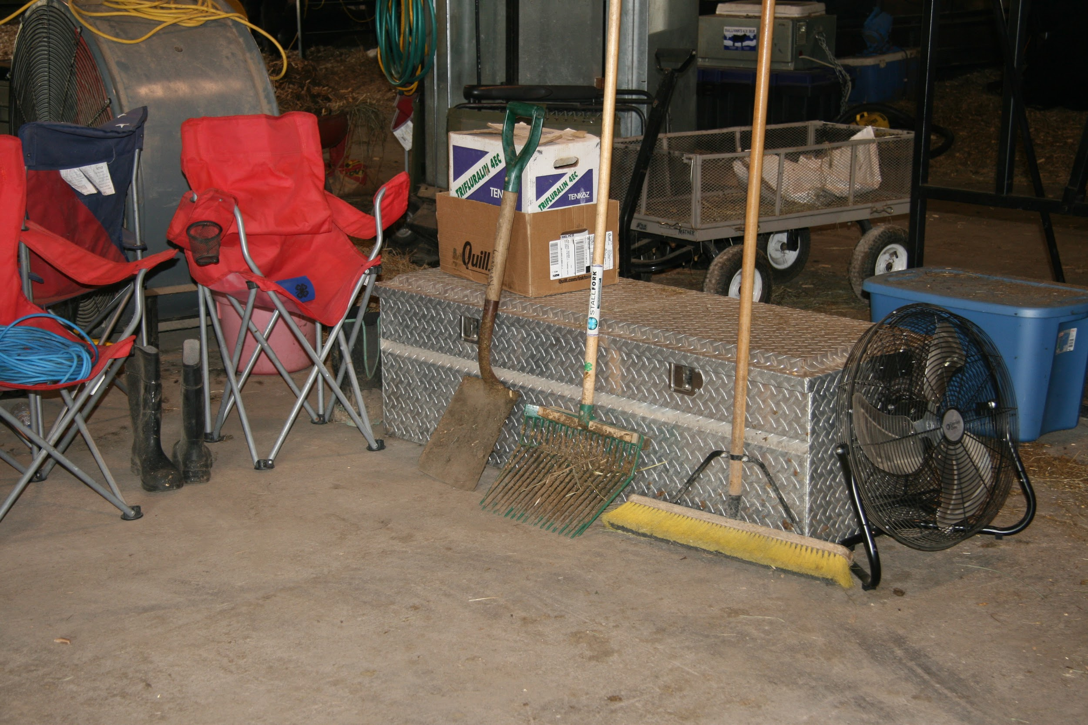
Animal Health at an Exhibition
Isolate sick animals from healthy animals
Quarantine animals for 7 days after returning home from an exhibition and watch for illness
Clean and disinfect any equipment, clothing, shoes, and vehicles that were at the fair
Notes:
Photo Source: Brittney Nelson, Iowa State University

Slide 29
References
Center for Food Security and Public Health website. Available at: http://www.cfsph.iastate.edu. Accessed Nov 18, 2016.
National Association of State Public Health Veterinarians website. Animals in public settings compendium, 2013. Available at: http://nasphv.org/Documents/AnimalContactCompendium2013.pdf. Accessed Jul 14, 2016.
National Association of State Public Health Veterinarians website. Measures to minimize influenza transmission at swine exhibitions, 2016. Available at: http://nasphv.org/Documents/Influenza_Transmission_at_Swine_Exhibitions_2016.pdf. Accessed Jul 14, 2016.

