Slide 1
This PowerPoint is a supplement to Lesson 4 of the Excellence in Exhibition: Preventing Disease in Animals and People course.
Notes:
Welcome to Excellence in Exhibition: Preventing Disease in Animals and People!
Animal agriculture is an important part of 4-H and FFA. Being a part of these organizations helps you gain knowledge about animals and develop responsibility, good sportsmanship, and confidence. However, there are many diseases that can be spread between people and animals, and knowing about these diseases is especially important because of the close contact that you have with your show animals.
This course was created to teach you how to keep yourself and your animals safe and healthy so that you can continue to enjoy showing and teaching others about animal agriculture.

Slide 2
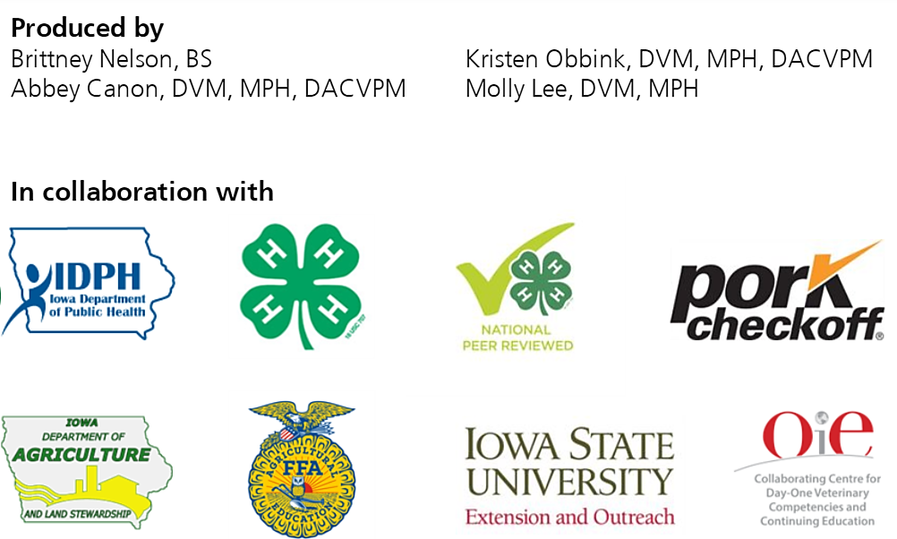
Acknowledgements
Iowa Department of Public Health receives funding for this project through a joint organizational partnership between the Council of State and Territorial Epidemiologists (CSTE) and the Centers for Disease Control and Prevention (CDC), provided by CSTE through sub-awards from the CDC cooperative agreement number: 5U38OT00143. The contents of this project are solely the responsibility of the authors and do not necessarily represent the official views of CDC or CSTE.
Notes:
Photos sources located in online version of lessons at www.bluenotflu.org

Slide 3
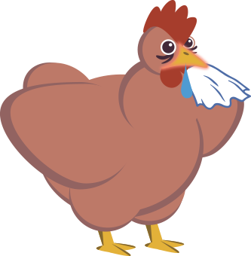
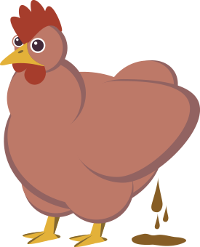
Highly Pathogenic Avian Influenza (HPAI) Outbreak
Notes:
Lesson 4 focuses on avian influenza, which is a zoonotic disease of birds. Avian influenza virus can cause serious disease in both poultry and people. Not all strains of avian influenza can be spread to people, but it is important to be aware of the risks and to do your best to prevent the spread of the virus. Taking precautions when working with your birds will help keep you and your animals healthy.

Slide 4
Learning Objectives
Describe avian influenza and how it is transmitted among animals and between animals and people.
Explain the impact that an HPAI outbreak has on animal agriculture.
Identify potential public health impacts of a highly pathogenic avian influenza outbreak.
Identify those persons most at risk for being infected with avian influenza A viruses and those with the highest risk of complications.
Explain how and why animal exhibitions might be impacted by HPAI.

Slide 5
Avian Influenza Virus in Birds
Classified as highly pathogenic avian influenza (HPAI) or low pathogenic avian influenza (LPAI) viruses
Species commonly affected: Pet birds, mammals, poultry, wild waterfowl
There is no specific treatment for avian influenza in birds
Spread among wild bird populations is often by ingestion of the virus in feces
Spread among domestic poultry is by ingestion, aerosol/droplets, fomites, and direct contact
Notes:
Avian influenza viruses are classified based on the genetic characteristics of the virus and the severity of the disease in domestic poultry. Viruses can be classified as highly pathogenic avian influenza (HPAI) or low pathogenic avian influenza (LPAI). HPAI viruses cause more severe disease in chickens than LPAI viruses. Species commonly affected by avian influenza are pet birds, mammals, and poultry. Some wild waterfowl can be carriers of the virus but do not show signs of disease. There is no specific treatment for avian influenza in birds. Because of the seriousness of the disease, birds with HPAI viruses are usually depopulated.
Avian influenza is spread among wild bird populations by ingestion. Birds will eat the feces of infected birds that contain the virus and become infected themselves. The virus can be transmitted among domestic poultry by ingestion, aerosol/droplets, fomites, and direct contact.

Slide 6
Avian Influenza in Birds
Clinical signs in domestic poultry
Depression
Ruffled feathers
Lack of appetite
Watery diarrhea
Swollen combs and wattles
Decreased egg production
Paralysis
Sudden death

Slide 7
Avian Influenza in People
Clinical signs
Fever
Aches
Pink-eye
Other flu-like symptoms such as cough, sore throat, runny nose, headache, and tiredness
Avian influenza viruses are capable of causing severe disease as well

Slide 8
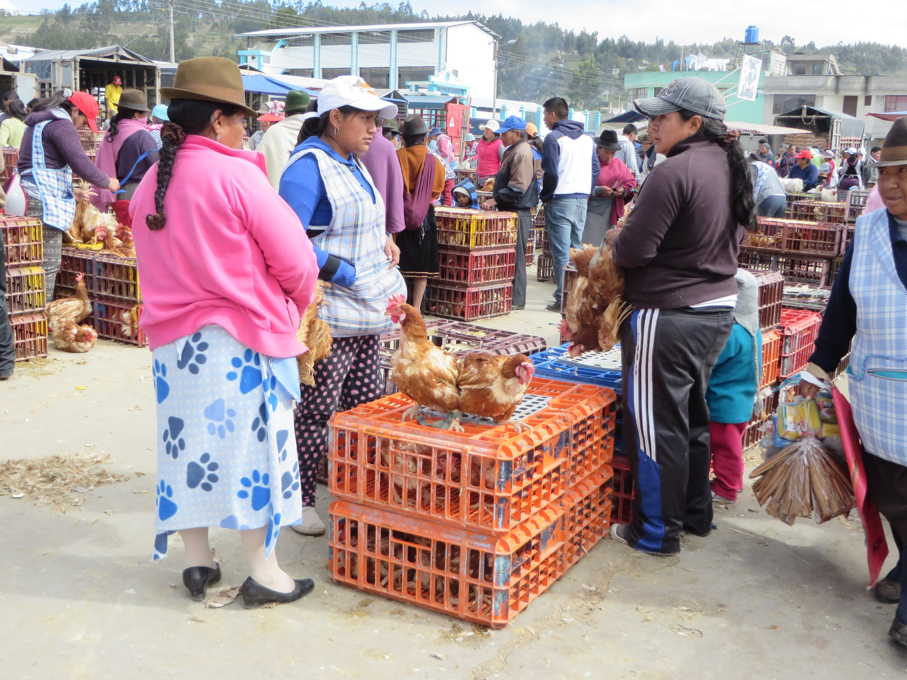
Avian Influenza in People
People are usually infected with avian influenza A viruses when they are in close contact with infected birds or tissues
People cannot get avian influenza from eating properly cooked poultry or poultry products
Human infections with avian influenza viruses are rare
Notes:
Photo Source: Katy Martin, Iowa State University

Slide 9
2015 HPAI Outbreak
Largest animal disease outbreak to date in the United States
Upper Midwest
50 million chickens and turkeys depopulated
$900 million spent on response
Notes:
The HPAI outbreak that began during the spring of 2015 was the largest U.S. animal disease outbreak to date. The outbreak occurred in the upper Midwest among laying hens, turkeys, and pullets. In total, 211 commercial flocks and 21 backyard flocks were affected. About 50 million chickens and turkeys were infected with or exposed to the virus and depopulated. Over $900 million was spent on response efforts.

Slide 10
2015 HPAI Outbreak
Notes:
Where did the 2015 outbreak strain of HPAI come from?

Slide 11
2015 HPAI Outbreak
Notes:
H5N8 HPAI emerged in January 2014 in Asia. It affected millions of chickens and ducks, mainly in Japan and South Korea.

Slide 12
2015 HPAI Outbreak
Notes:
In November 2014 the virus was found in commercial poultry and a wild duck in Germany.

Slide 13
2015 HPAI Outbreak
Notes:
In December 2014, the virus was isolated from commercial poultry in the Netherlands, the United Kingdom, and Italy.

Slide 14
2015 HPAI Outbreak
Notes:
Migrating wild birds probably carried the virus to Alaska. At some point a bird was infected with both the H5N8 HPAI virus and a North American LPAI virus at the same time. Those two viruses mixed together and made two new viruses. These viruses infected wild birds, backyard poultry, and commercial poultry in British Columbia, Washington, Oregon, Idaho, and California in late 2014 and early 2015.

Slide 15
2015 HPAI Outbreak
Notes:
In March 2015, H5N2 (an HPAI subtype of one of the new viruses) infected a backyard flock in Kansas, two commercial turkey farms in Missouri, and a commercial turkey farm in Arkansas. All of those flocks were depopulated and no other outbreaks occurred in those states

Slide 16
2015 HPAI Outbreak
Notes:
Also in March, the HPAI virus infected a commercial turkey flock in Minnesota. The virus became highly adapted to commercial poultry and quickly spread to many turkey farms in Minnesota.

Slide 17
2015 HPAI Outbreak
Notes:
In April 2015, the first case of the HPAI virus in a commercial egg-laying facility occurred in northwest Iowa.

Slide 18
2015 HPAI Outbreak
Notes:
The last case of the 2015 HPAI outbreak in Minnesota was detected on June 6, 2015. The last case of the 2015 HPAI outbreak in Iowa was detected on June 16, 2015.

Slide 19
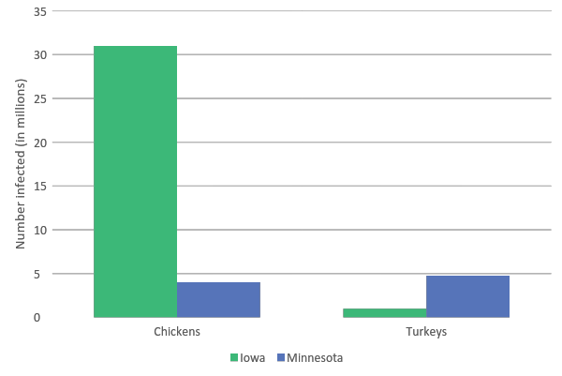
Birds Infected with HPAI in 2015
Notes:
Over 31 million chickens from 37 different flocks in Iowa and 4 million chickens from 5 different flocks in Minnesota were infected with HPAI and depopulated.
Over 1 million turkeys from 35 different flocks in Iowa and 4.75 million turkeys from 104 different flocks in Minnesota were infected with HPAI and depopulated.

Slide 20
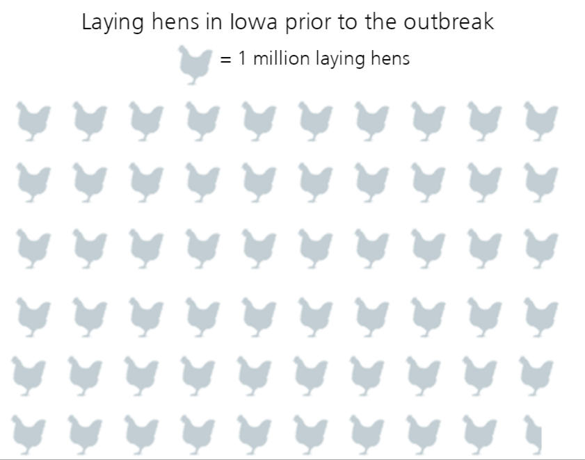
Agricultural Impact

Slide 21
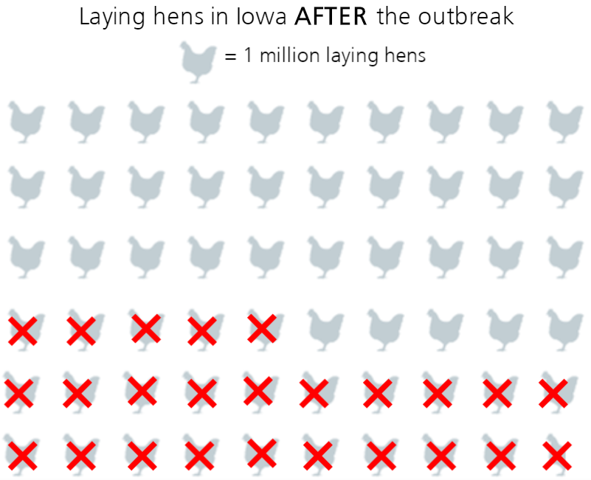
Agricultural Impact

Slide 22
Agricultural Impact
United States lost 3% of its annual turkey production and 10% of its laying hen population
$1.2 billion economic impact in Iowa
$3 billion economic impact in the United States
Job market affected
Other countries limited importation of U.S. poultry and poultry products, including eggs
Notes:
The United States lost 3% of its annual turkey production and 10% of its laying hen population because of HPAI. Prior to the outbreak, Iowa had 59.5 million laying hens, produced 16.5 billion eggs annually, and had 11 million turkeys. The outbreak resulted in a loss of 25 million laying hens and 1.1 million turkeys. In Iowa alone the economic impact was estimated to be $1.2 billion. The economic impact in the entire United States was estimated to be over $3 billion.
Poultry workers were laid off because of the stop of production for depopulation, cleaning, and disinfection of facilities. Workers in the egg industry were also affected. There are more than 20,000 jobs in Iowa and 12,000 jobs in Minnesota associated with the egg industry. Other businesses such as processing plants, feed mills, trucking companies, food production companies, and retail stores were affected as well.
In addition, many countries limited importation of U.S. poultry and poultry products, including eggs.

Slide 23
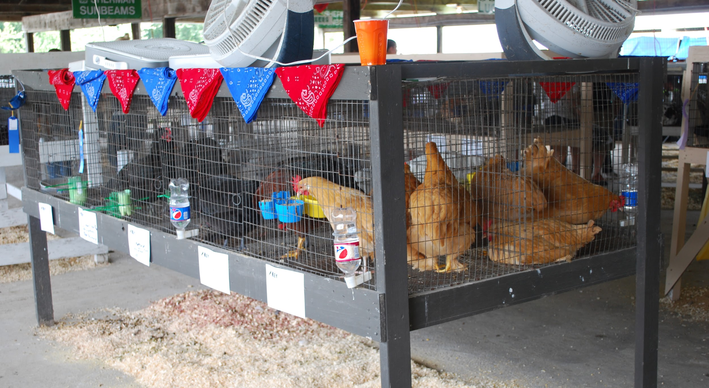
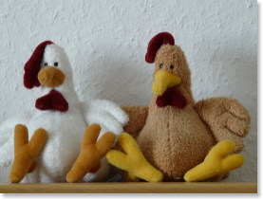
Exhibition Impact
Several states banned poultry exhibitions
Live bird exhibitions
Waterfowl exhibitions
Out-of-state waterfowl
Out-of-state birds
Bans were put in place to reduce the spread of HPAI in poultry
Some exhibitions provided alternatives for showing live birds
Notes:
As a result of the HPAI outbreak, several states banned poultry exhibitions. Iowa and Minnesota, along with many other states, placed bans on all live bird exhibitions during 2015. Some states banned waterfowl, out-of-state waterfowl, or out-of-state birds from exhibitions. These bans were put in place to reduce the spread of HPAI in poultry populations.
Instead of having live birds, some exhibitions provided activities to educate the public on the poultry industry. Many 4-H shows provided alternative projects, such as competing in showmanship classes with bird models or stuffed animals, for those who had been planning on showing poultry.
Photo Source: Pam Zaabel, Iowa State University

Slide 24
Public Health Impact
There were no human infections reported with the outbreak strain of the virus during the 2015 HPAI outbreak
Some avian influenza viruses have zoonotic and pandemic potential
People are usually infected when they come in close contact with infected birds or their tissues
Because some H5 and H7 viruses have caused severe disease in people, including death, public health works closely with animal health when such outbreaks occur
Notes:
During the 2015 HPAI outbreak there were no human infections with the outbreak strain of the virus. However, avian influenza viruses do have zoonotic and pandemic potential. The two most common zoonotic avian influenza viruses are the Asian H5N1 HPAI virus and the H7N9 LPAI virus that has caused disease in China. People are usually infected with avian influenza when they come in close contact with infected birds or their tissues. Some people are at higher risk for developing severe complications due to an infection with avian influenza viruses. Those people include: children less than 5 years of age, pregnant women, people 65 years and old, people with weakened immune systems, and people with certain medical conditions. Because some H5 and H7 viruses have caused severe disease in people, including death, public health works closely with animal health when such outbreaks occur.

Slide 25
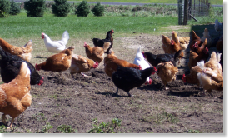
Avian Influenza Prevention for Poultry Owners
Isolate birds from visitors and other birds
Keep clothing, boots, equipment, cages, and vehicles clean
Avoid sharing equipment with your neighbors
Be able to recognize signs of disease in birds
Report any unusual signs of disease or unexpected deaths in your birds to your veterinarian

Slide 26
References
Animal and Plant Health Inspection Service website. Biosecurity for birds. Available at: https://www.aphis.usda.gov/aphis/ourfocus/animalhealth/animal-disease-information/avian-influenza-disease/birdbiosecurity. Accessed Jul 15, 2016.
Centers for Disease Control and Prevention website. Influenza. Available at: https://www.cdc.gov/flu/. Accessed Feb 20, 2017.
Center for Food Security and Public Health website. Available at: http://www.cfsph.iastate.edu. Accessed Nov 18, 2016.
National Association of State Public Health Veterinarians website. Animals in public settings compendium, 2013. Available at: http://nasphv.org/Documents/AnimalContactCompendium2013.pdf. Accessed Jul 14, 2016.
U.S. Senate Committee on Agriculture, Nutrition, and Forestry website. Highly pathogenic avian influenza: the impact on the U.S. poultry sector and protecting U.S. poultry flocks. Available at: http://www.agriculture.senate.gov/hearings/highly-pathogenic-avian-influenza-the-impact-on-the-us-poultry-sector-and-protecting-us-poultry-flocks. Accessed Jun 15, 2016.

