Slide 1
This PowerPoint is a supplement to Lesson 5 of the Excellence in Exhibition: Preventing Disease in Animals and People course.
Notes:
Welcome to Excellence in Exhibition: Preventing Disease in Animals and People!
Animal agriculture is an important part of 4-H and FFA. Being a part of these organizations helps you gain knowledge about animals and develop responsibility, good sportsmanship, and confidence. However, there are many diseases that can be spread between people and animals, and knowing about these diseases is especially important because of the close contact that you have with your show animals.
This course was created to teach you how to keep yourself and your animals safe and healthy so that you can continue to enjoy showing and teaching others about animal agriculture.

Slide 2
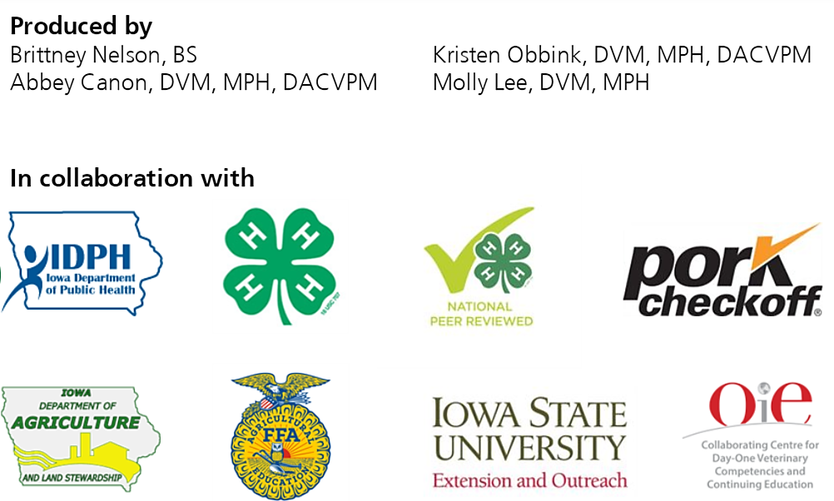
Acknowledgements
Iowa Department of Public Health receives funding for this project through a joint organizational partnership between the Council of State and Territorial Epidemiologists (CSTE) and the Centers for Disease Control and Prevention (CDC), provided by CSTE through sub-awards from the CDC cooperative agreement number: 5U38OT00143. The contents of this project are solely the responsibility of the authors and do not necessarily represent the official views of CDC or CSTE.
Notes:
Photos sources located in online version of lessons at www.bluenotflu.org

Slide 3
Influenza A Virus of Swine Origin (H3N2v) Outbreak
Notes:
Lesson 5 will help you to learn more about Influenza A viruses of swine (IAV-S). IAV-S has caused disease in pigs and people at fairs in the past. However, taking simple precautions will help to keep both you and your pigs healthy so that you can continue to enjoy working with and showing your animals.

Slide 4
Learning Objectives
Describe influenza A viruses of swine and how they can be transmitted among animals and to humans.
Explain measures to protect swine from infection with influenza viruses.
Identify the public health impacts of the H3N2v virus outbreak.
Identify those persons most at risk for being infected with swine influenza A viruses and those with the highest risk of complications.
Explain the measures humans can take to protect themselves from influenza A viruses of swine when on farms or attending animal exhibitions.

Slide 5
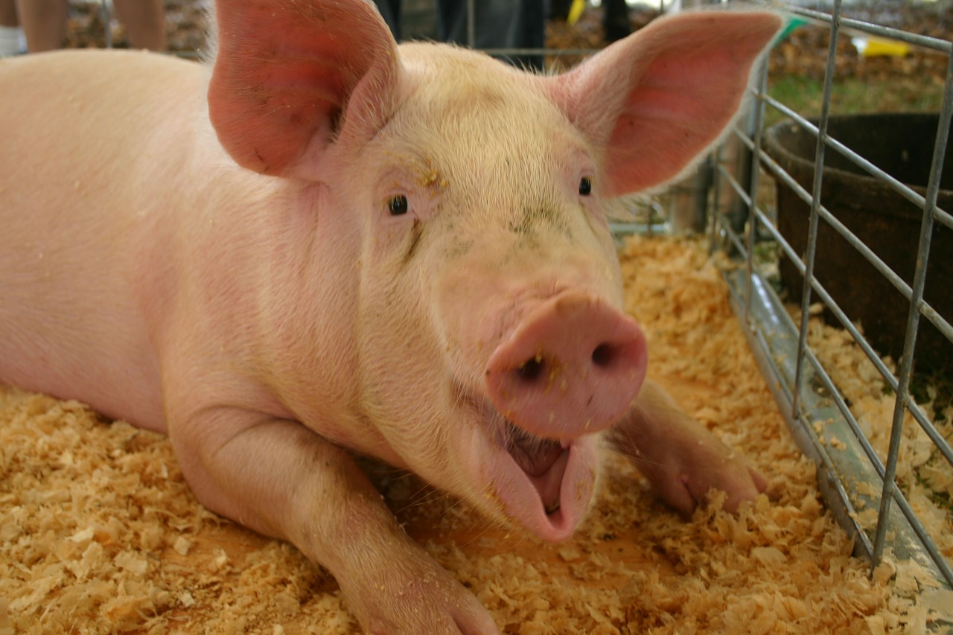
Influenza A Virus of Swine Origin
Species commonly affected: pigs, turkeys, mink, ferrets
Spread by aerosol and contact with nasal discharge, either directly or on fomites
Seasonal influenza viruses can be spread from humans to pigs
Notes:
Pigs, turkeys, mink, and ferrets can be infected by influenza A of swine viruses. Humans can become infected with IAV-S as well. The influenza virus is transmitted between pigs by aerosol and contact with nasal discharge, either directly or on fomites. Seasonal influenza viruses can be spread from humans to pigs. This happens more commonly than pigs spreading the disease to humans.
Photo Source: https://pixabay.com/en/pig-full-grown-farm-mouth-open-75381/

Slide 6
Influenza A Virus of Swine Origin
Clinical signs in pigs
Fever
Tiredness
Lack of appetite
Weight loss
Coughing
Sneezing
Nasal discharge
Labored breathing

Slide 7
IAV-S in People
Clinical signs in humans include flu-like symptoms such as fever, cough, sore throat, runny nose, muscle aches, headache, and tiredness
Influenza viruses normally found in pigs are called “variant” viruses when they are found in people
H3N2v
Spread from pigs to humans by aerosol/droplet transmission when people are in close contact with pigs
Fomite transmission is also possible
Notes:
Clinical signs of IAV-S in humans include flu-like symptoms such as fever, cough, sore throat, runny nose, muscle aches, headache, and tiredness. Influenza viruses normally found in pigs are called “variant” viruses when they are found in people. Adding the letter “v” to the end of the virus subtype shows that it is a variant virus, for example H3N2v. H3N2v is a variant influenza virus that was first detected in people in 2011.
The influenza virus is thought to be spread to people when an infected pig coughs or sneezes and the droplets with influenza virus are spread through the air. If the droplets land on a person’s nose or mouth, or are inhaled, the person can become infected. It is also possible that a person can get the virus from touching an object with the virus on it and then touching their nose or mouth.

Slide 8
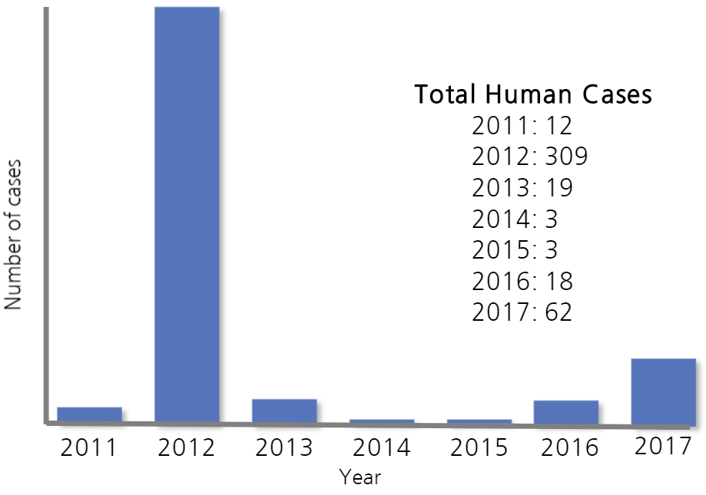
H3N2v Cases— United States, 2011–2017
Notes:
H3N2v was first detected in people in 2011. In 2012 it was responsible for over 300 human cases, almost all of which were associated with fair attendance and contact with swine.

Slide 9
H3N2v Cases in 2012
Median Age of Humans Infected: 7 years
Median Age of Hospitalized Humans: 5 years
Number of Deaths: 1

Slide 10
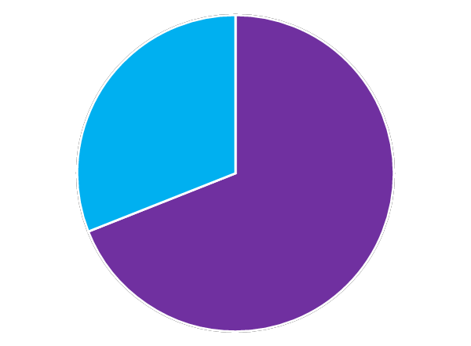
H3N2v Cases in 2012
5.2% of infected people were hospitalized
69% of people hospitalized were in one of the ‘high risk’ categories for influenza complications
Of the 16 people hospitalized, 1 died

Slide 11
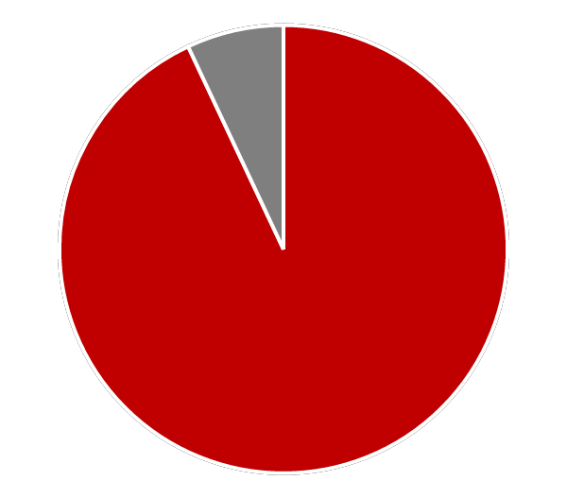
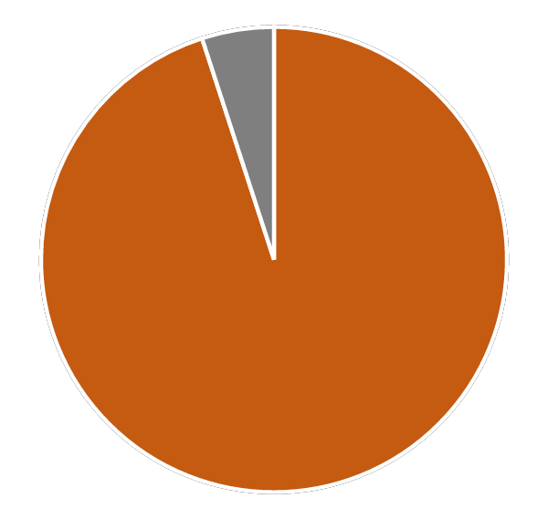
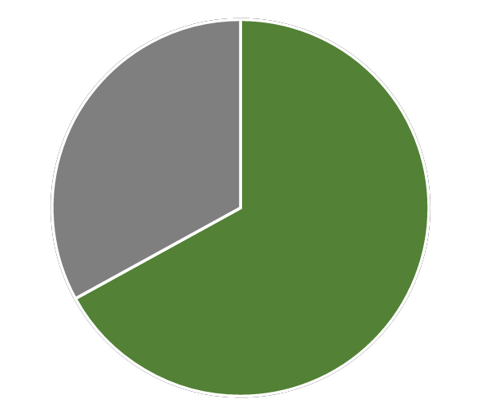
H3N2v Cases in 2012
93% of infected people said they attended an agricultural fair
95% of infected people said they had contact with pigs
Almost 67% of infected people said they had contact with pigs for multiple days

Slide 12
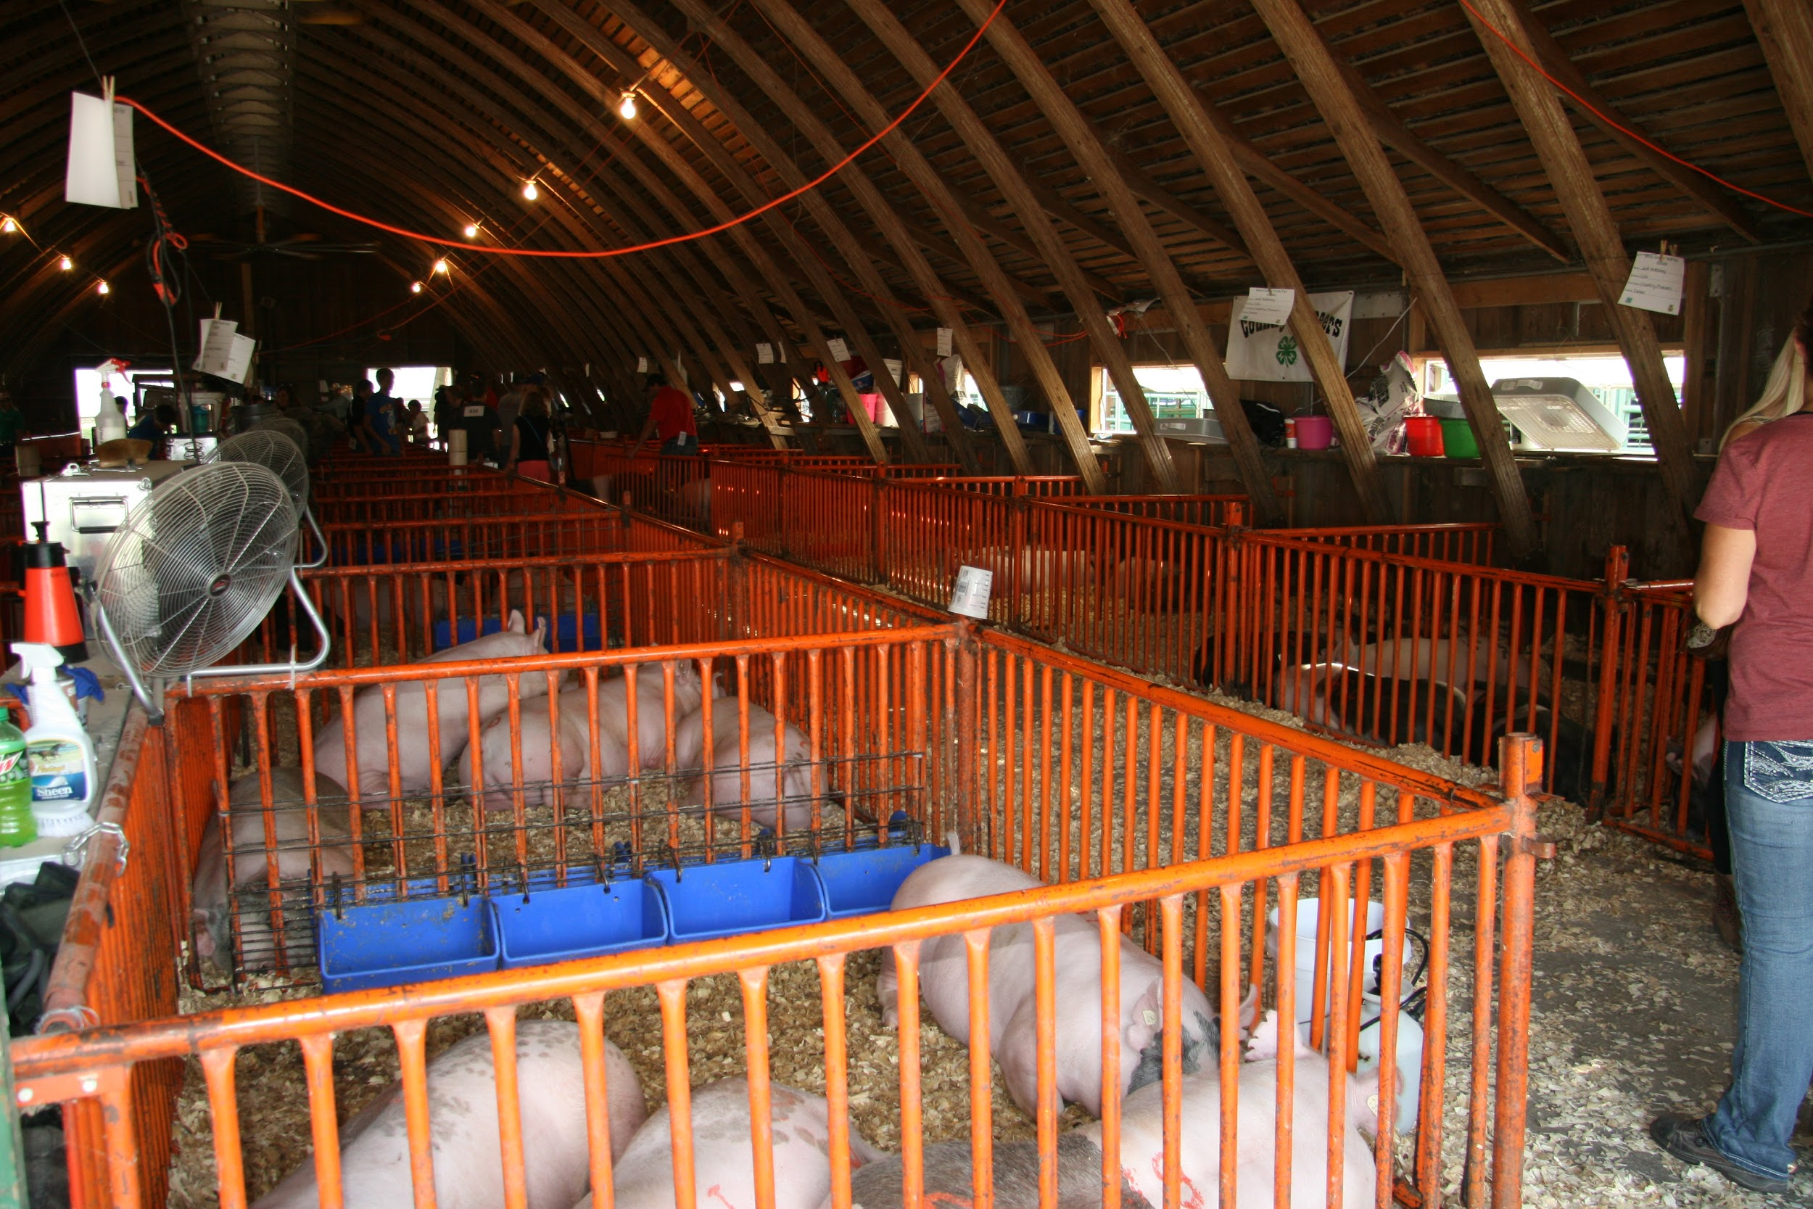
Risks for Infection with H3N2v
Close contact with infected swine
Repeated exposure to swine
Large numbers of pigs in one area
Large numbers of people in contact with pigs
Potentially contaminated environment
Notes:
Photo Source: Brittney Nelson, Iowa State University

Slide 13
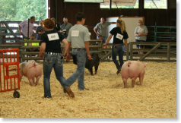
Exhibition Impact— Indiana, 2012
Veterinarians checked all pig temperatures
Normal 101.5–103.5ºF
Only allowed pigs with temperature <105ºF onto grounds
Veterinarians sent all pigs home after finding 6 ill pigs
Notes:
After pigs and exhibitors tested positive for H3N2v influenza following county fairs in 2012, the Indiana State Fair took precautions to prevent the spread of the virus.
Veterinarians and fair officials checked all pigs’ temperatures before they came onto the fairgrounds. Normal pigs have a temperature of 101.5–103.5ºF. Veterinarians allowed only pigs with a temperature less than 105ºF onto the grounds, and observed pigs throughout the entire fair. After finding 6 pigs ill, all pigs were sent home early.
Since then, exhibitions have increased prevention measures to minimize the risk of influenza transmission while still allowing swine to be present.

Slide 14
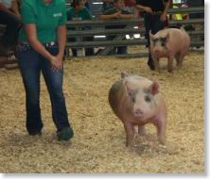
Exhibition Impact— Ohio, 2017
July 12, 2017—pig at Ohio county fair tested positive for H3N2 influenza
More pigs began to show signs next day
Ohio Department of Agriculture quarantined hog barn
Allowed only exhibitors and parents in to care for pigs
State veterinarian made show terminal to protect other hog farms and people
All pigs were sent directly to slaughter and not allowed to return home
Notes:
On July 12, 2017, a pig at an Ohio county fair tested positive for H3N2 influenza. The next day, more pigs began to show signs of influenza.
The Ohio Department of Agriculture (ODA) placed a quarantine on the hog barn. ODA allowed only exhibitors and their parents into the barn to care for their animals.
Because so many pigs were getting sick so quickly, the state veterinarian made the show terminal. Exhibitors were still able to show their healthy animals, but to protect other hog farms and people, all pigs at the fair, regardless of their intended purpose, were sent directly to slaughter and not allowed to return home.

Slide 15
Minimize Influenza Risk
Exhibitions should have isolation areas in place for animals that become sick
Long-term swine exhibits should be kept away from competition swine
Breeding shows should be done before terminal swine shows, or there should be a break between shows to allow for cleaning and disinfection
Pigs should only spend 72 hours at an exhibition to limit the spread of the virus between pigs
Notes:
After several pigs and 4-Hers tested positive for H3N2v following county fairs in 2012, the Indiana State Fair took precautions to prevent the spread of disease. All pigs’ temperatures were checked before they came onto the fairgrounds. The normal temperature for a pig is 101.5 degrees F to 103.5 degrees F. Only pigs with a temperature of less than 105 degrees were allowed on the grounds. Pigs were also observed throughout the entire fair. After finding six pigs ill, all swine were sent home early. Since then, exhibitions have increased prevention measures to minimize the risk of disease while still allowing swine to be present.
Exhibitions should have isolation areas in place for any animals that become sick while at the exhibition. Long-term swine exhibitions should be kept away from competition swine to prevent contact. If an exhibition has both breeding and terminal swine shows, the breeding show should be done first or there should be a break between shows to allow for cleaning and disinfection. It is suggested that pigs only spend 72 hours at the exhibition to limit the spread of disease between pigs.

Slide 16
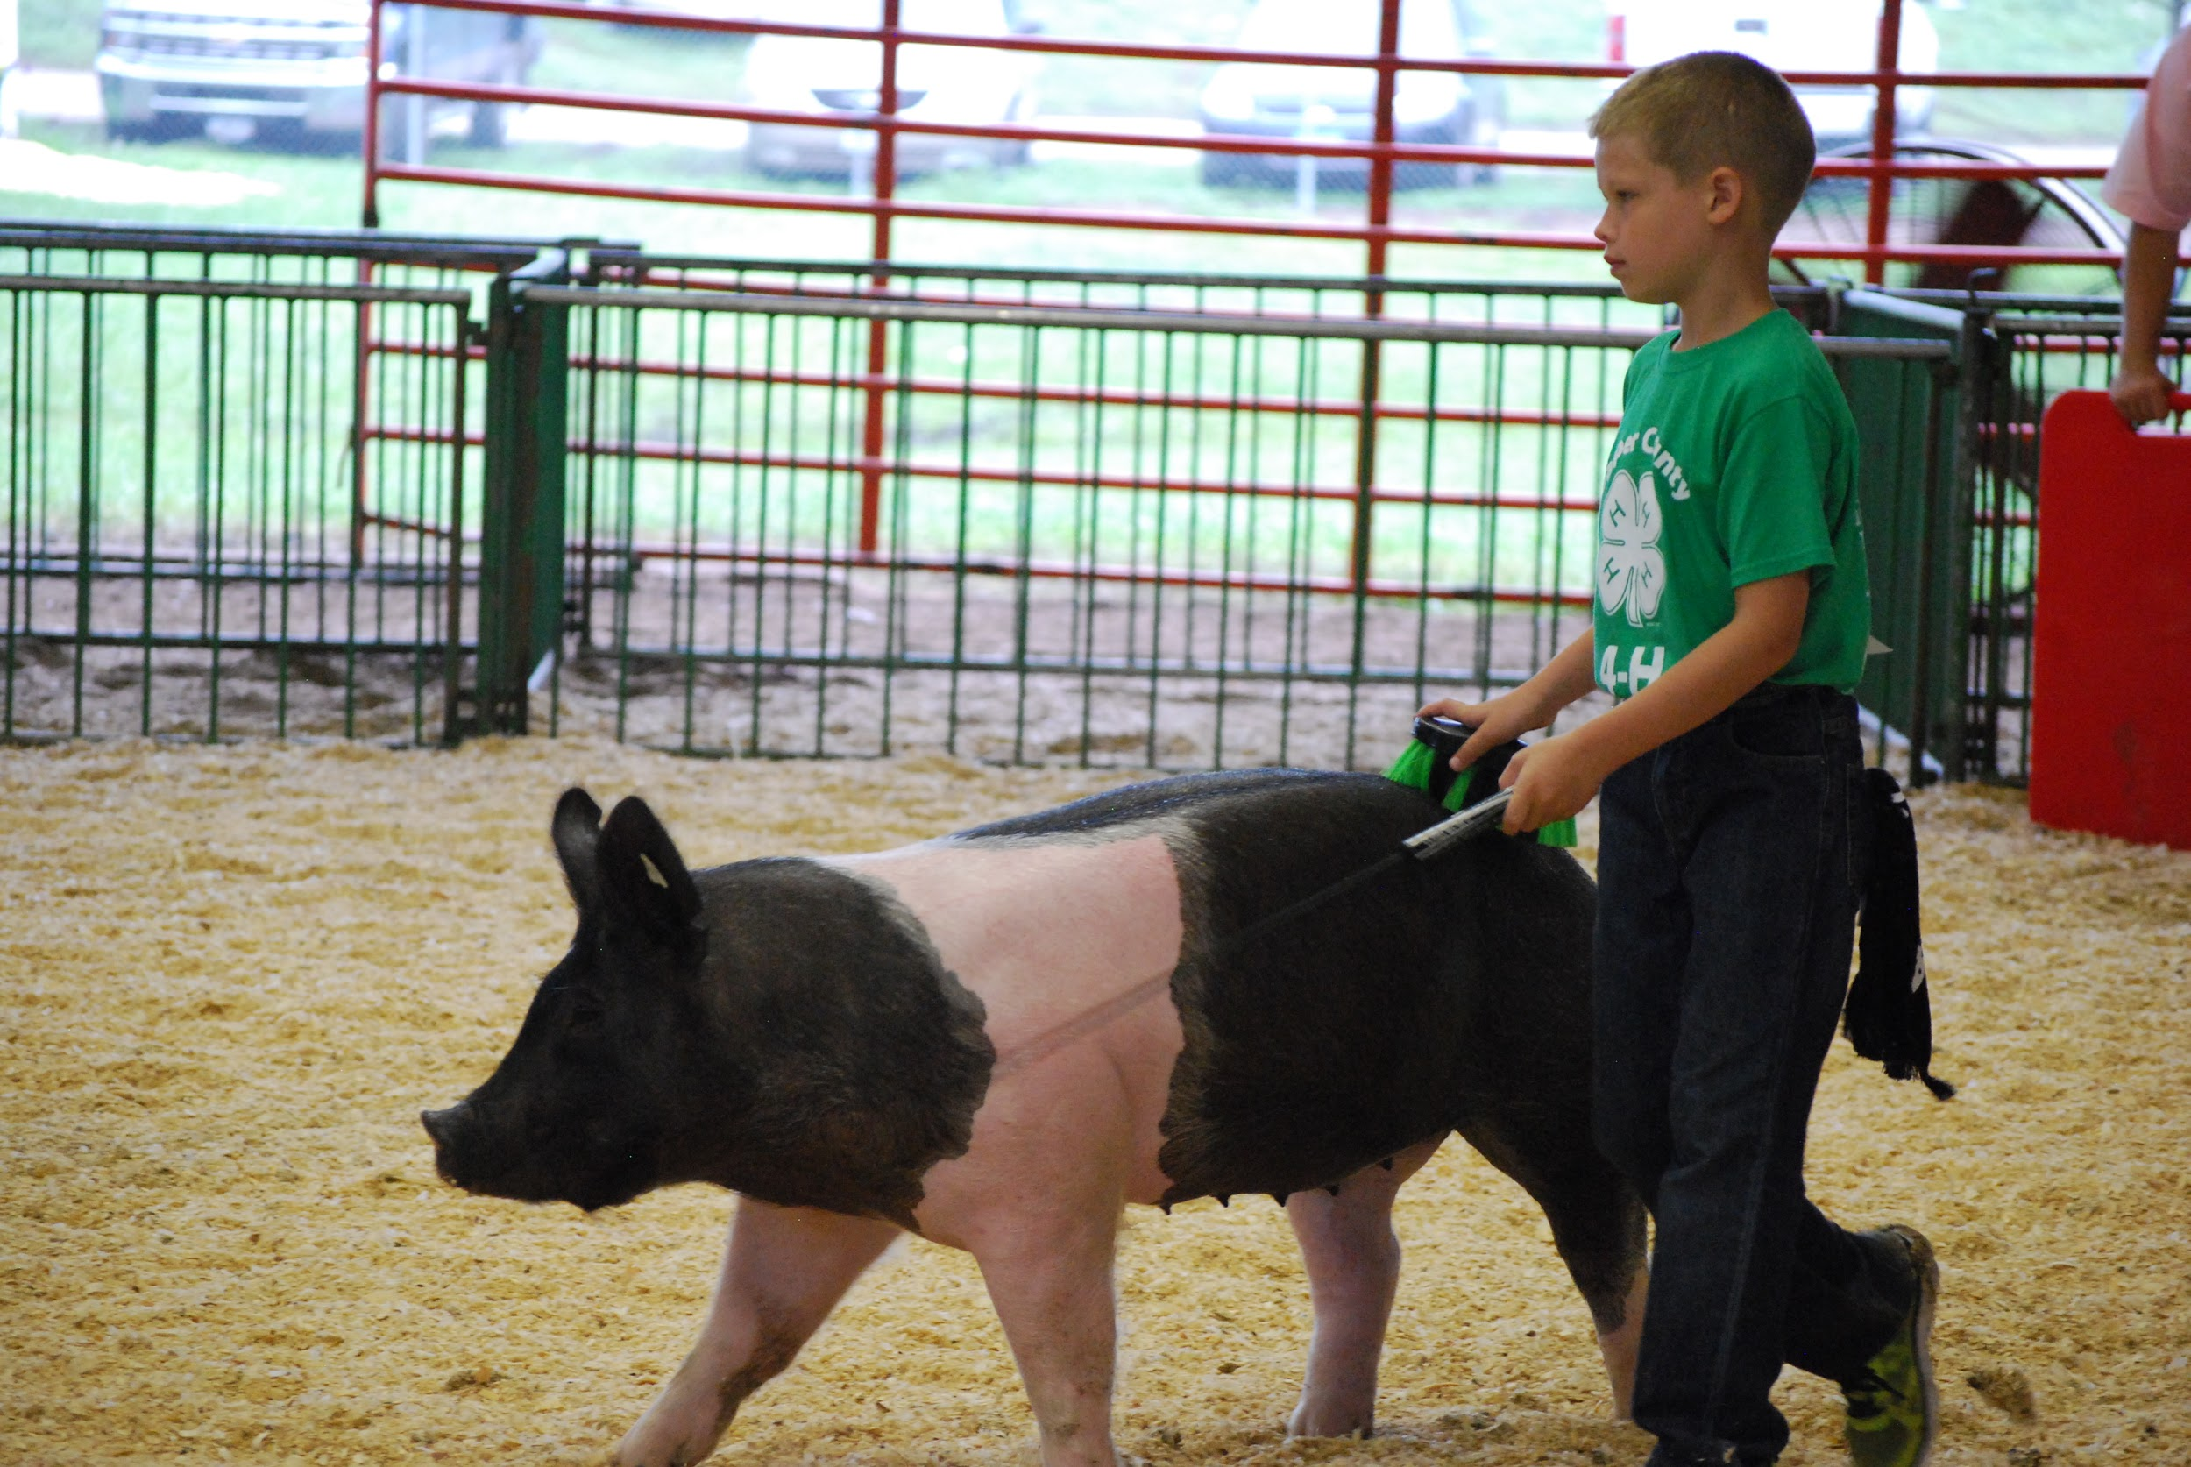
Public Health Impact
Most variant infections are mild and similar to the seasonal flu
Serious illness is possible
Those most likely to be infected are people in close contact with pigs
Person-to-person transmission of the virus is limited
Notes:
So far most infections with H3N2v have been mild and similar to seasonal flu infections. As with the seasonal flu, serious illness is possible, especially in people with a high risk of flu-related complications. Since 2012, the H3N2v virus contains a gene from the 2009 H1N1 pandemic virus. This gene may allow the virus to infect humans more easily than swine influenza viruses typically can.
The people most likely to be infected with an influenza A virus of swine are those who are in close contact with pigs. Person-to-person transmission of IAV-S is limited. However, because of the ability of influenza viruses to quickly change, it is possible that the virus could change to allow for more efficient person-to-person transmission.
Photo Source: Pam Zaabel, Iowa State University

Slide 17
Prevention Measures to
Protect Swine
Do not bring sick animals to an exhibition
Avoid taking swine to multiple exhibitions
Avoid mixing of animals from different farms
Limit the amount of time your animals spend at an exhibition
Avoid sharing equipment with other exhibitors
Avoid contact with pigs if you have flu-like symptoms to avoid spreading the illness to pigs

Slide 18
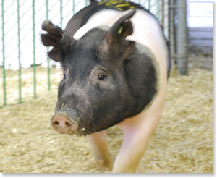
Prevention Measures to
Protect Swine
Observe swine regularly for signs of illness
Contact your veterinarian if your pig becomes sick
Quarantine animals for at least 7 days before allowing contact with other animals after a show
Clean and disinfect equipment, shoes, clothing, and vehicles that were at the exhibition before using them on your farm

Slide 19
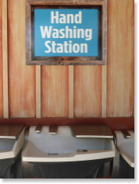
Prevention Measures to
Protect Humans
Avoid eating and drinking in animal areas
Wash your hands often, especially before and after pig exposure
Avoid sleeping in animal areas
Avoid putting anything in your mouth while in swine barns
Leave toys, pacifiers, cups, strollers, etc. outside of the animal areas

Slide 20
Prevention Measures to
Protect Humans
Avoid pigs and swine areas if you are at a high risk of flu complications
Children less than 5 years of age
Pregnant women
People 65 years and older
People with weakened immune systems
People with certain medical conditions
Avoid contact with pigs that look or act sick
Take protective measures, such as wearing PPE, if you must come in contact with pigs that are known or suspected to be sick

Slide 21
References
Centers for Disease Control and Prevention website. Influenza. Available at: https://www.cdc.gov/flu/. Accessed Feb 20, 2017.
Center for Food Security and Public Health website. Available at: http://www.cfsph.iastate.edu. Accessed Nov 18, 2016.
Jhung MA, Epperson S, Biggerstaff M, et al. Outbreak of variant influenza A virus (H3N2) virus in the United States. Clin Infect Dis 2013;57:1703-1712.
National Association of State Public Health Veterinarians website. Animals in public settings compendium, 2013. Available at: http://nasphv.org/Documents/AnimalContactCompendium2013.pdf. Accessed Jul 14, 2016.
National Association of State Public Health Veterinarians website. Measures to minimize influenza transmission at swine exhibitions, 2016. Available at: http://nasphv.org/Documents/Influenza_Transmission_at_Swine_Exhibitions_2016.pdf. Accessed Jan 14, 2017.

