Slide 1
This PowerPoint is a supplement to Lesson 6 of the Excellence in Exhibition: Preventing Disease in Animals and People course.
Notes:
Welcome to Excellence in Exhibition: Preventing Disease in Animals and People!
Animal agriculture is an important part of 4-H and FFA. Being a part of these organizations helps you gain knowledge about animals and develop responsibility, good sportsmanship, and confidence. However, there are many diseases that can be spread between people and animals, and knowing about these diseases is especially important because of the close contact that you have with your show animals.
This course was created to teach you how to keep yourself and your animals safe and healthy so that you can continue to enjoy showing and teaching others about animal agriculture.

Slide 2
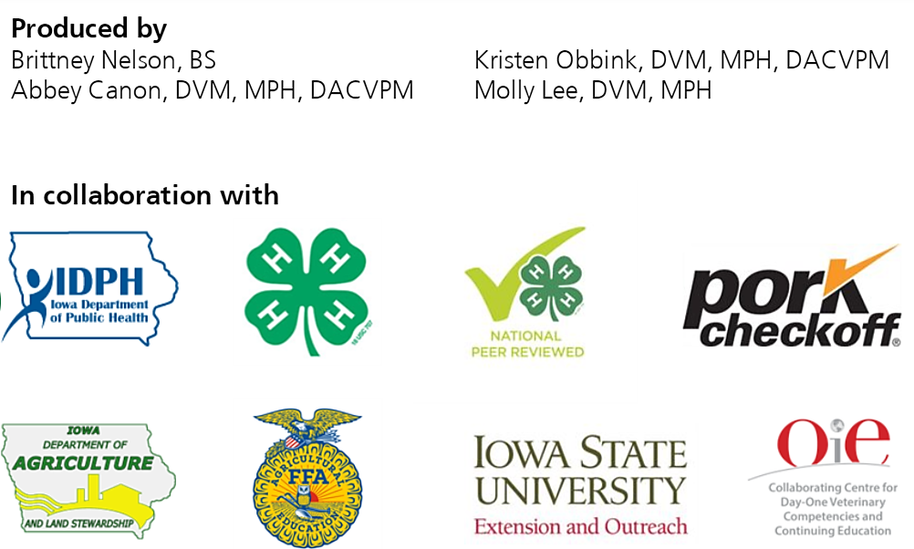
Acknowledgements
Iowa Department of Public Health receives funding for this project through a joint organizational partnership between the Council of State and Territorial Epidemiologists (CSTE) and the Centers for Disease Control and Prevention (CDC), provided by CSTE through sub-awards from the CDC cooperative agreement number: 5U38OT00143. The contents of this project are solely the responsibility of the authors and do not necessarily represent the official views of CDC or CSTE.
Notes:
Photos sources located in online version of lessons at www.bluenotflu.org

Slide 3
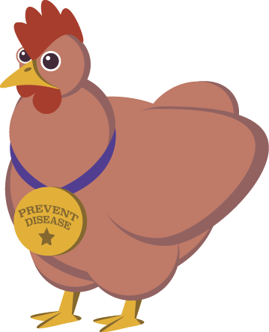
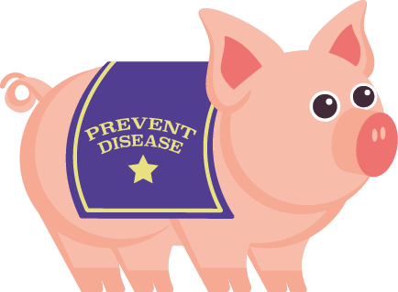
One Health Agencies and Careers
Notes:
This lesson will introduce you to many agencies and careers that put One Health into practice. It also combines the information you’ve learned in the other lessons and shows how that knowledge can be used in a One Health approach to a zoonotic disease outbreak.

Slide 4
Learning Objectives
Identify agencies that promote animal and public health.
Recognize careers that are available in animal and public health.
Describe the education and responsibilities that different animal and public health jobs require.

Slide 5
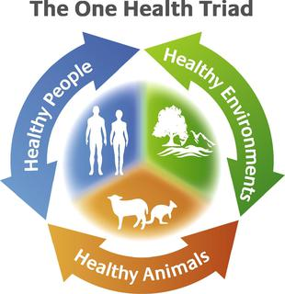
One Health
One Health is an approach that recognizes that the health of humans is connected to the health of animals and the environment. The goal of One Health is to encourage the collaborative efforts of multiple disciplines locally, regionally, nationally, or globally to achieve the best health for people, animals, and our environment.
Notes:
Photo source: https://en.wikipedia.org/wiki/One_Health_Model

Slide 6
Agencies Promoting Animal and Public Health
Notes:
There are many different agencies that work to promote both animal and public health. These agencies can operate at the local, state, or national level. Agencies within each of these categories have the ability to impact populations at all levels. This presentation describes some of the common agencies that employ public health workers. However, people in the public health field can work in many different places, not just the ones listed here.

Slide 7
Local Agencies

Slide 8
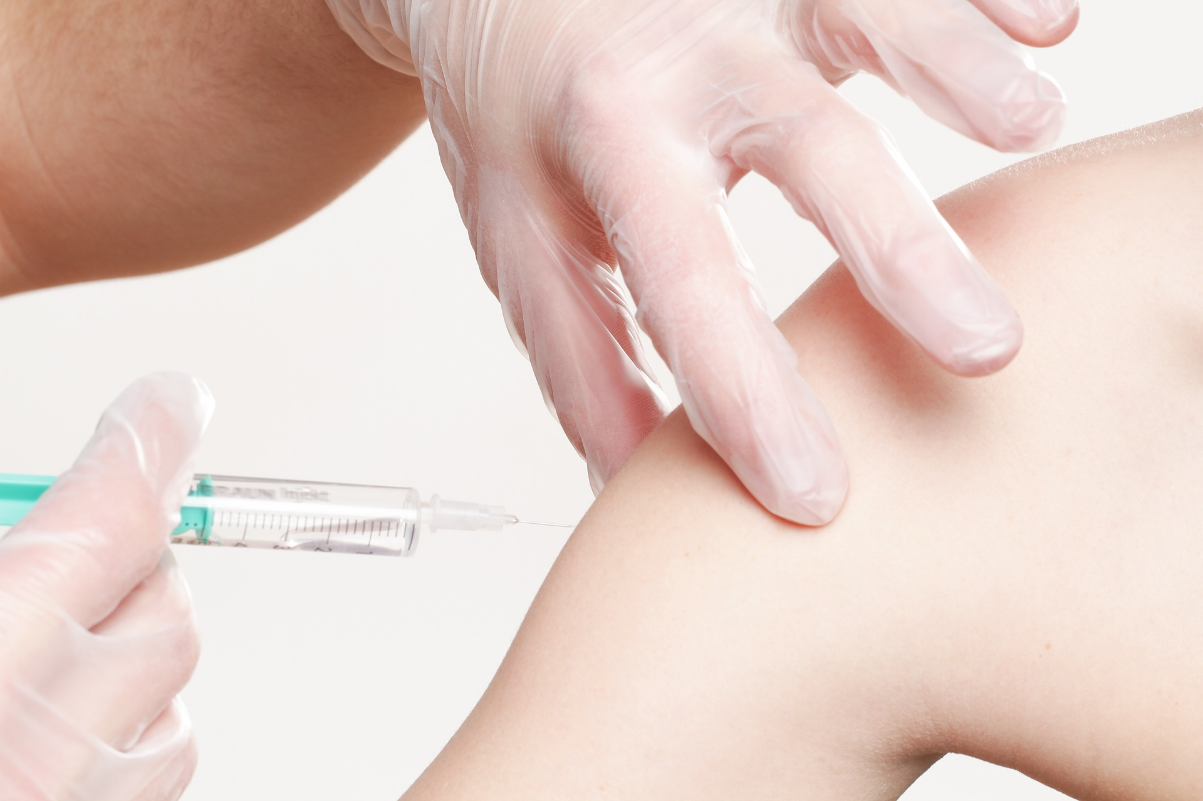
Local Health Department
Gives immunizations
Investigates reportable disease cases and outbreaks
Provides food safety education
Provides food service establishment inspections
Offers nutrition programs

Slide 9
State Agencies and Personnel

Slide 10
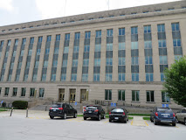
State Health Department
Conducts disease surveillance (keeping track of diseases throughout the state)
Investigates outbreaks
Prepares for and responds to public health emergencies

Slide 11
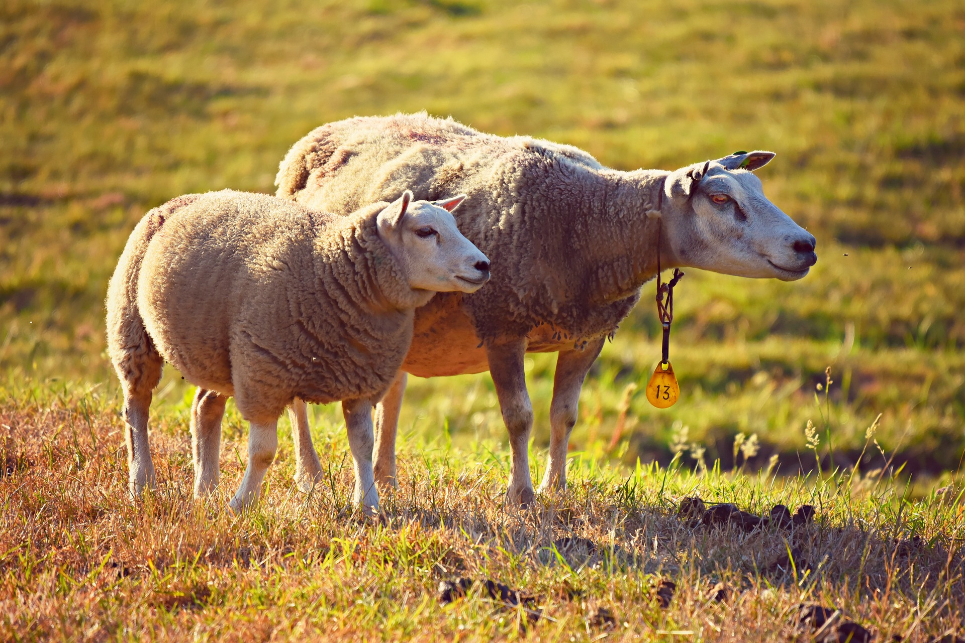
v
State Veterinarian
Protects livestock, the livestock industry, and consumers by enforcing rules and regulations on elimination and control of certain animal diseases
Licenses and inspects pet feed and rendering plants to ensure the safety of finished products

Slide 12
State Public Health Veterinarian
Works on zoonotic disease control and prevention
Coordinates vector control for diseases spread by mosquitoes, ticks, and other insects
Provides recommendations regarding rabies exposures
Works in epidemiology conducting disease surveillance and outbreak investigation

Slide 13
National Agencies

Slide 14
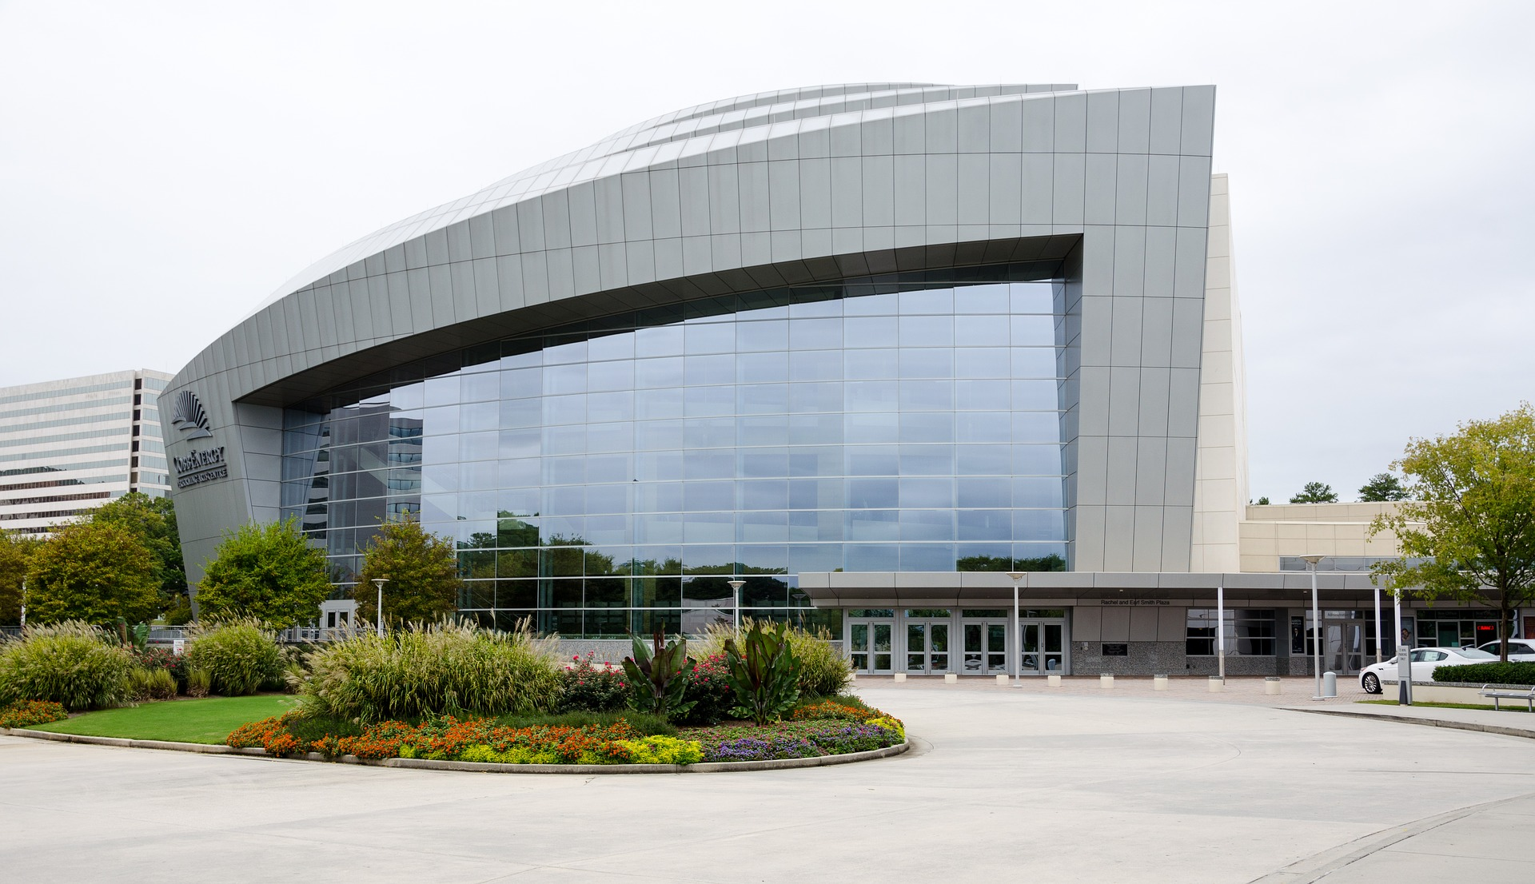
Centers for Disease Control and Prevention (CDC)
Monitors, detects, and investigates health problems
Conducts research to improve disease prevention
Recommends disease prevention strategies
Develops and promotes public health policies
Promotes healthy behaviors
Protects Americans from pandemics and other public health threats

Slide 15
United States Department of Agriculture (USDA)
Expands markets for agricultural products and supports economic development in other countries
Develops new markets for agricultural products and activities
Enhances food safety from farm to table
Ensures that meat and poultry is safe, wholesome, and clean
Improves health and nutrition

Slide 16
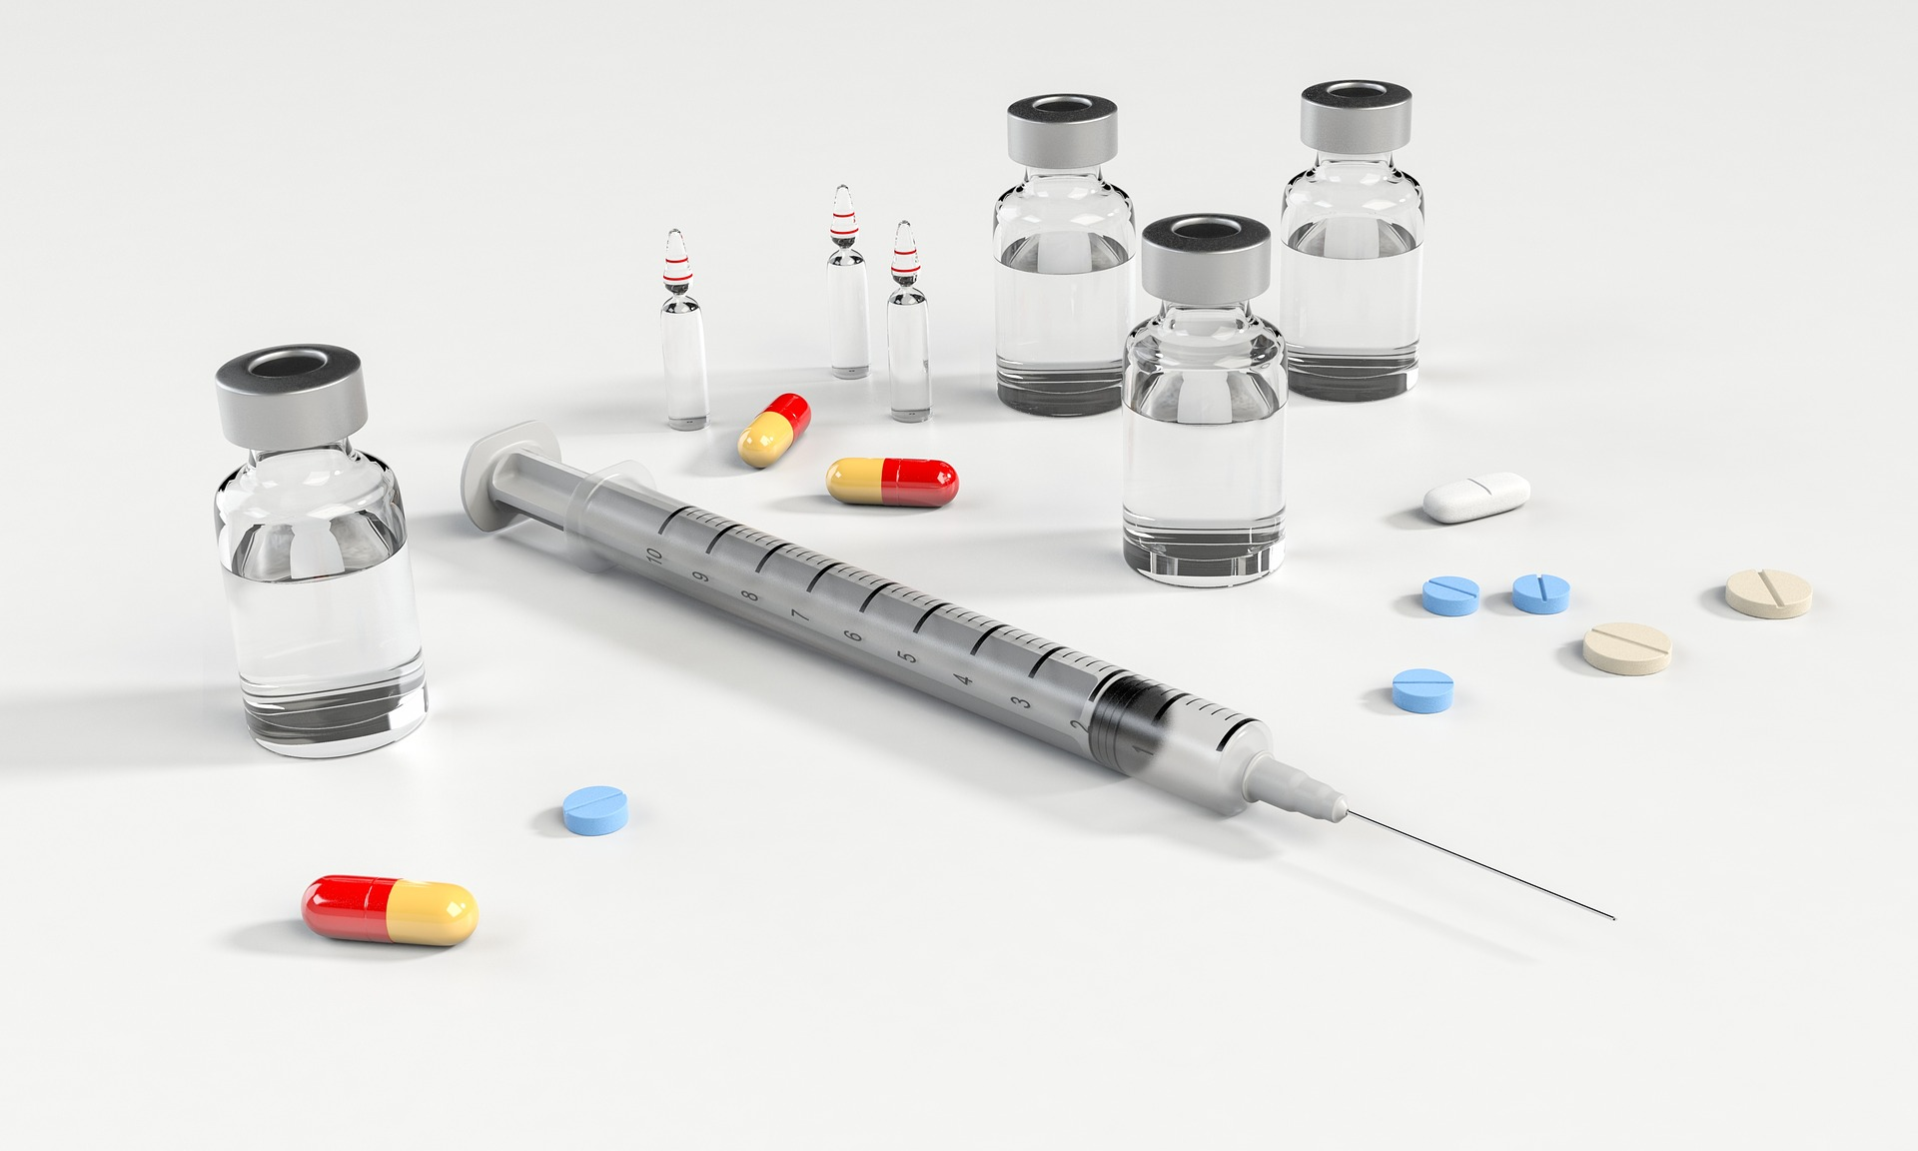
U.S. Food and Drug Administration (FDA)
Ensures that food (except meat and poultry, which is regulated by the USDA) is safe, wholesome, clean, and properly labeled
Ensures that human and veterinary drugs are safe, effective, and properly labeled
Makes sure food for animals is safe, clean, and properly labeled

Slide 17
Careers in Animal
and Public Health

Slide 18
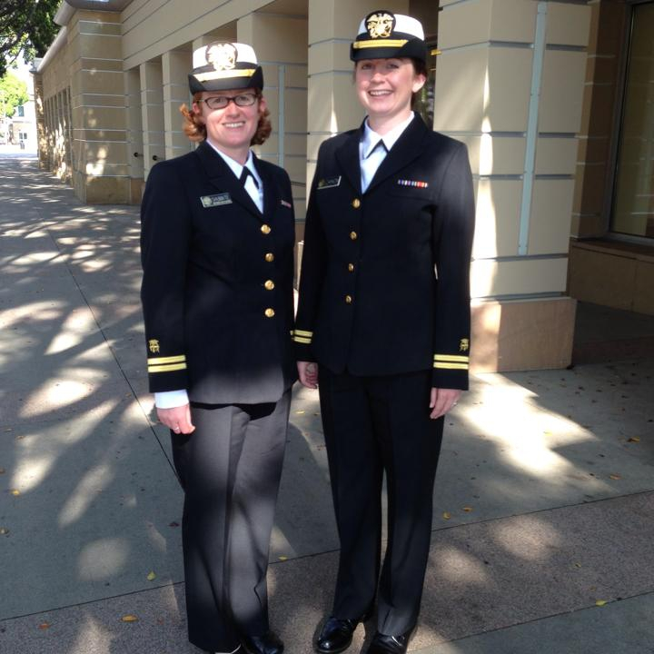
Epidemiologist
Disease detectives
Investigate disease outbreaks
Work at health departments, CDC, FDA, and USDA
May need master’s degree in public health
Notes:
Epidemiologists investigate disease outbreaks and are often called “disease detectives”. They work to identify people with the illness, determine the cause, and make recommendations for preventing and controlling disease.
Epidemiologists are often employed by local and state health departments, CDC, FDA, and USDA.
Depending on where they work, epidemiologists might need to obtain a master’s degree, usually a Master of Public Health.

Slide 19
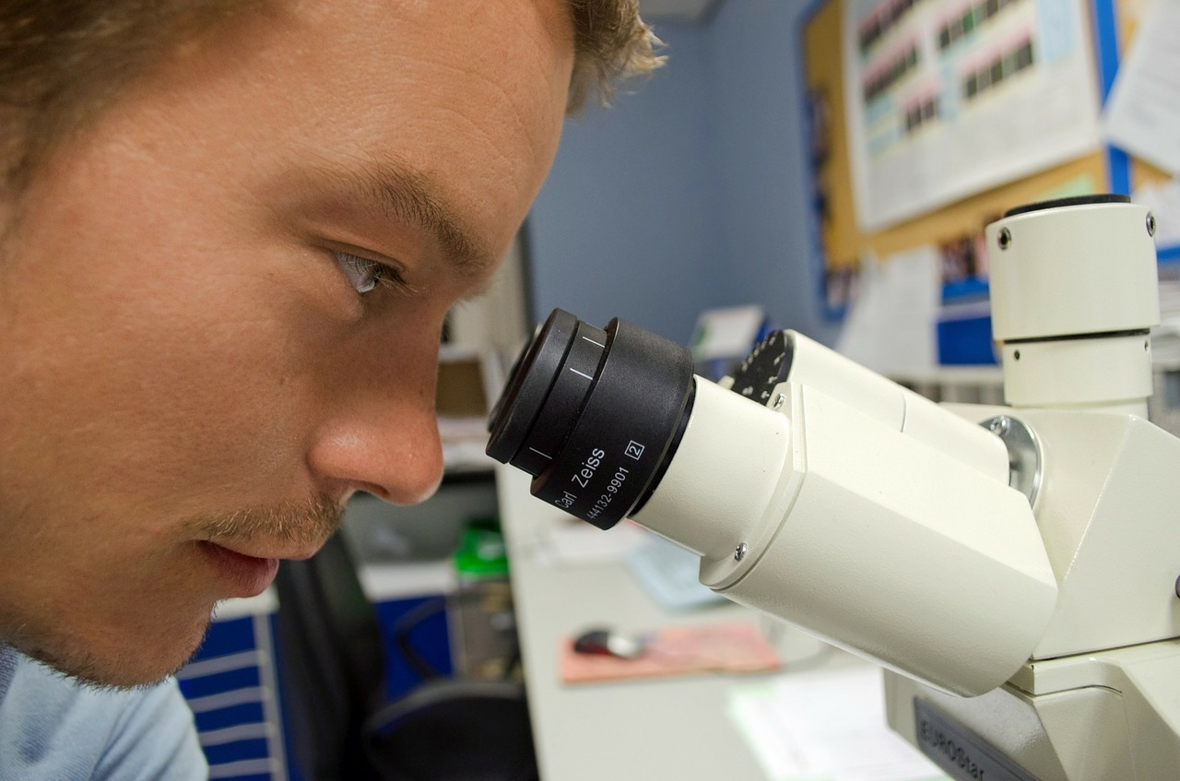
Public Health Laboratory Scientist
Perform tests
May work for government agencies
Usually have a bachelor’s degree in a science-related field and sometimes master’s degree in public health
Notes:
People who work in public health laboratories perform screening tests, diagnostic tests, and surveillance tests. They can aid in investigating disease outbreaks and research infectious diseases.
Laboratory scientists will often work for government agencies.
They usually have a bachelor’s degree in a science-related field and sometimes a master’s degree in public health.

Slide 20
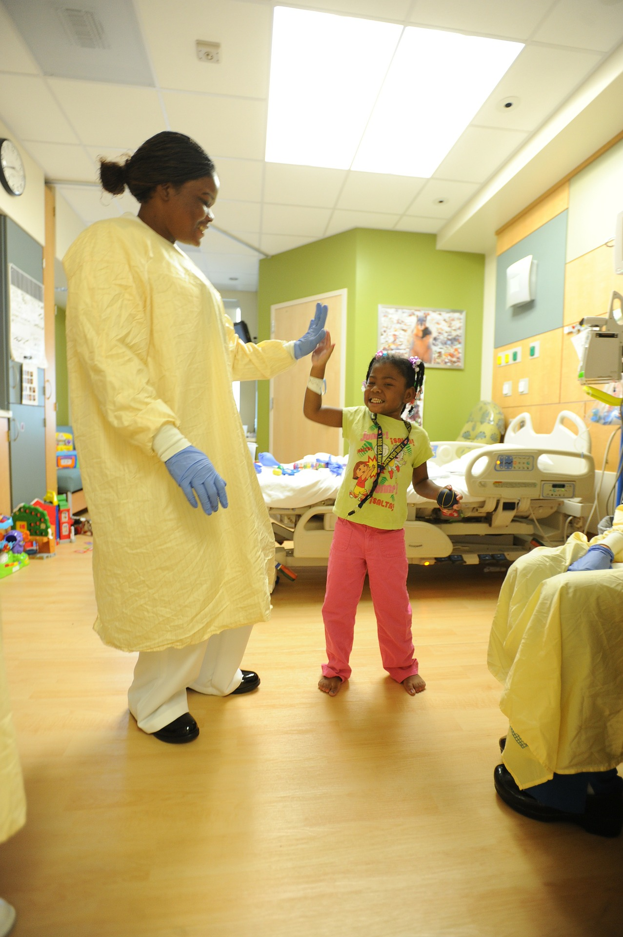
Nurse
Monitor health conditions
Administer medicine
Provide care for patients
Notes:
Nurses work with other healthcare providers to monitor health conditions, administer medicine, and provide care for patients.

Slide 21
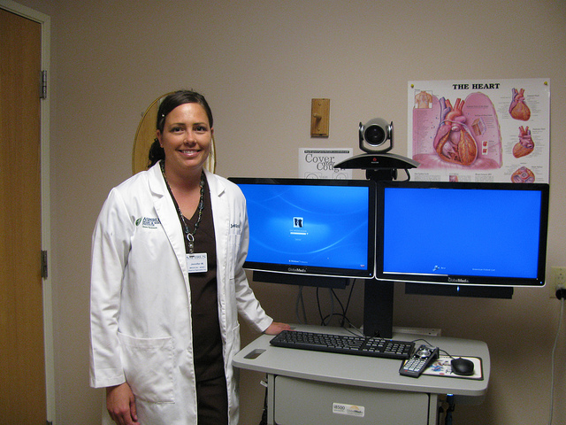
Public Health Nurse
Improve the health of the community
Often employed by local health departments and occupational health facilities
May need an associate’s or bachelor’s degree in nursing
Notes:
One specialty type of nurse is a public health nurse. Public health nurses work to improve the health of the community. They help to identify health issues within a community and create intervention strategies for health issues such as improper diet and sexually transmitted diseases.
Public health nurses are often employed by local health departments and occupational health facilities.
Depending on where they work, public health nurses may need either an associate’s degree or bachelor’s degree in nursing.
Photo Source: USDA

Slide 22
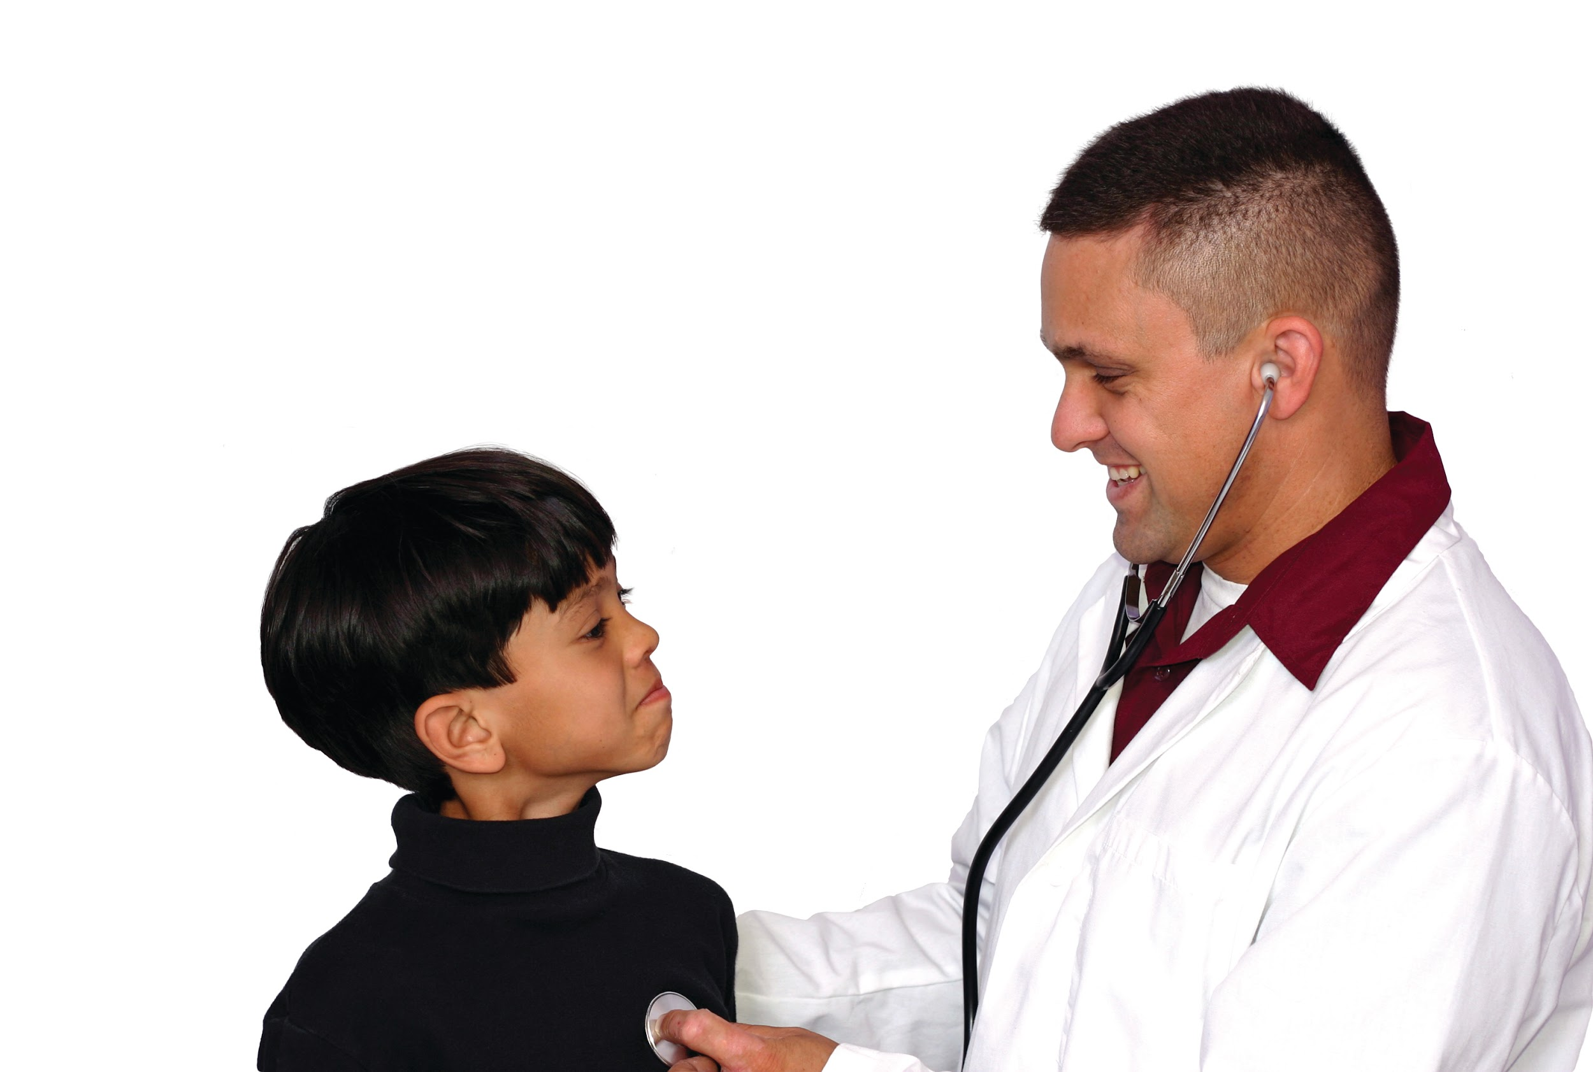
Physician
Responsible for human health
Diagnose illness
Prescribe medications
Develop treatment plans
Perform surgery
Need a Doctor of Medicine (M.D.) or a Doctor of Osteopathic Medicine (D.O.) degree
Notes:
Physicians are responsible for the health of humans. Some of their duties include diagnosing illness, prescribing medications, and developing special treatment plans. Some specialized physicians will also perform surgery.
To be a physician, you need to have a Doctor of Medicine (M.D.) or a Doctor of Osteopathic Medicine (D.O.) degree. Most physicians also have bachelor’s degrees.
Photo Source: iStock

Slide 23
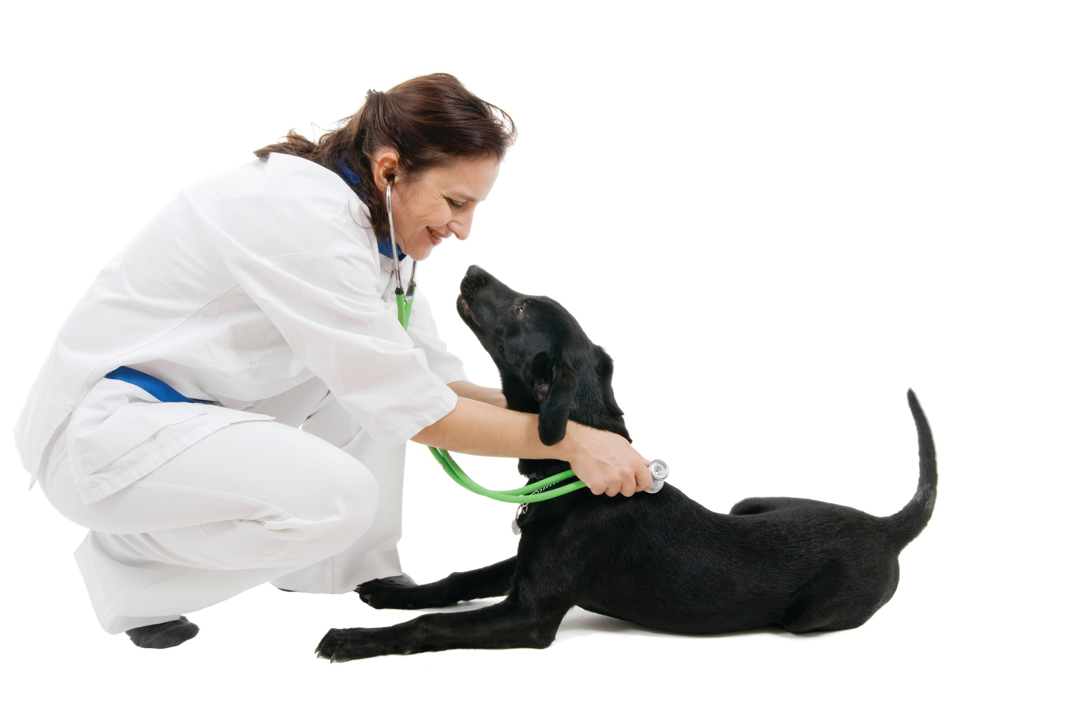
Veterinarian
Responsible for animal and public health
Give vaccines
Diagnose and treat illness and injury
Perform surgery
Conduct research
Need a Doctor of Veterinary Medicine (D.V.M or V.M.D)
Notes:
Veterinarians are responsible for animal health and public health. They perform many duties including giving vaccines, diagnosing and treating illnesses and injuries, and doing surgery. Veterinarians can also conduct research, work in food safety, or in public health.
Veterinarians need a Doctor of Veterinary Medicine degree (DVM or VMD). Most veterinarians also have a bachelor’s degree.
Photo Source: iStock

Slide 24
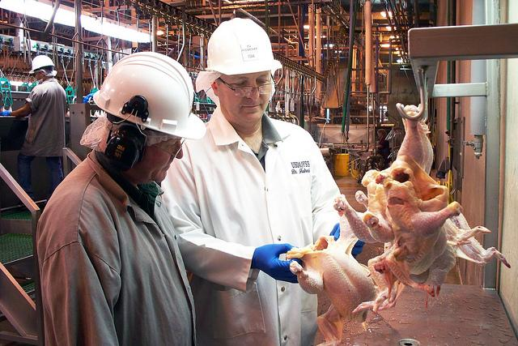
Public Health Veterinarian
Focuses on the interaction between animal and human health
May work in food safety, disaster preparedness, zoonoses prevention, epidemiology, drug and vaccine safety, occupational health
Employed by health departments, CDC, USDA FDA, National Park Service, industry or companies
Notes:
A public health veterinarian is a veterinarian who focuses on the interaction between animal and human health. They can work in many different fields, including food safety, disaster preparedness efforts, zoonoses prevention, epidemiology, drug and vaccine safety, and occupational health.
Public health veterinarians are employed by local and state health departments, USDA, CDC, FDA, the National Park Service, private companies, industry groups, and many other agencies and organizations.
Public health veterinarians need a Doctor of Veterinary Medicine degree and a Master of Public Health degree.
Photo Source: USDA

Slide 25
Roles in a Disease Outbreak
Notes:
The next slides show the role that individuals in each of these careers might play in a zoonotic disease outbreak. However, during a disease outbreak many people will step into other roles and provide assistance wherever needed. Animal health and human health skills are often linked and can be used in a variety of settings.

Slide 26
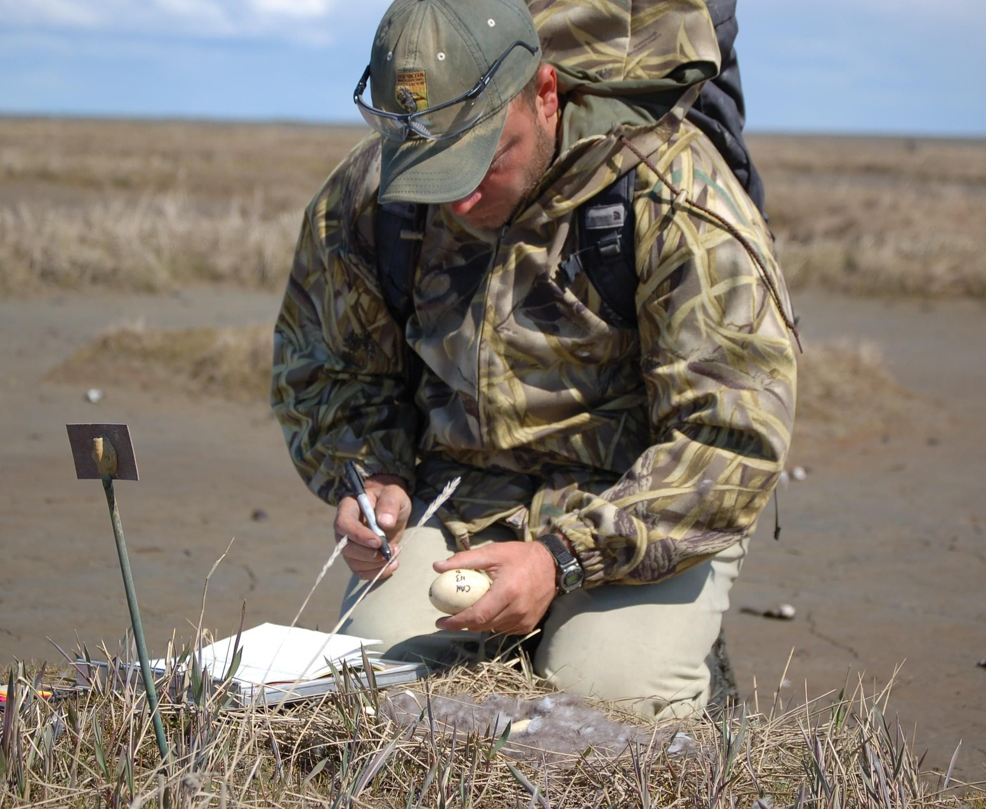
Epidemiologist
Create a case description (standard set of criteria for deciding whether an individual should be classified as having the disease)
Identify cases
Interview patients
Describe the outbreak in terms of time, place, and person
Determine the cause and route of spread of the disease
Make recommendations for preventing and controlling disease

Slide 27
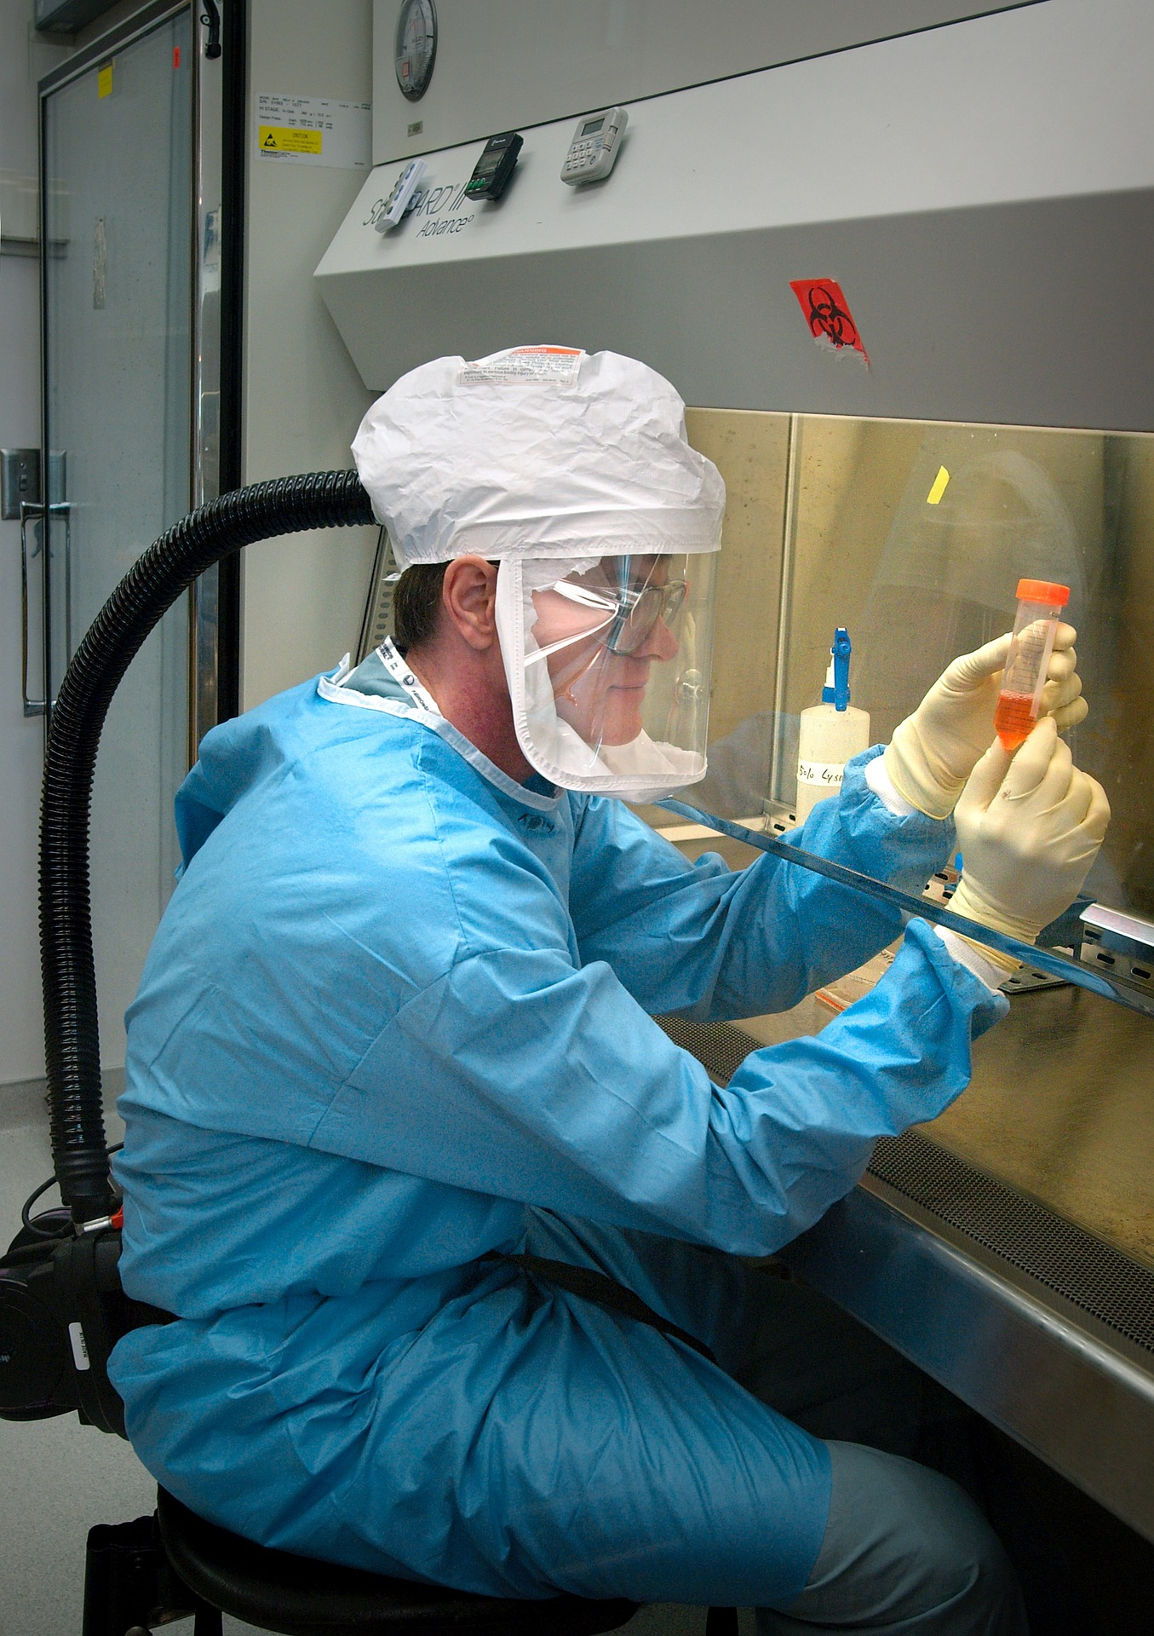
Public Health Laboratory Scientist
Perform laboratory analysis on samples
Determine the cause of disease
Determine what can be used to treat the disease

Slide 28
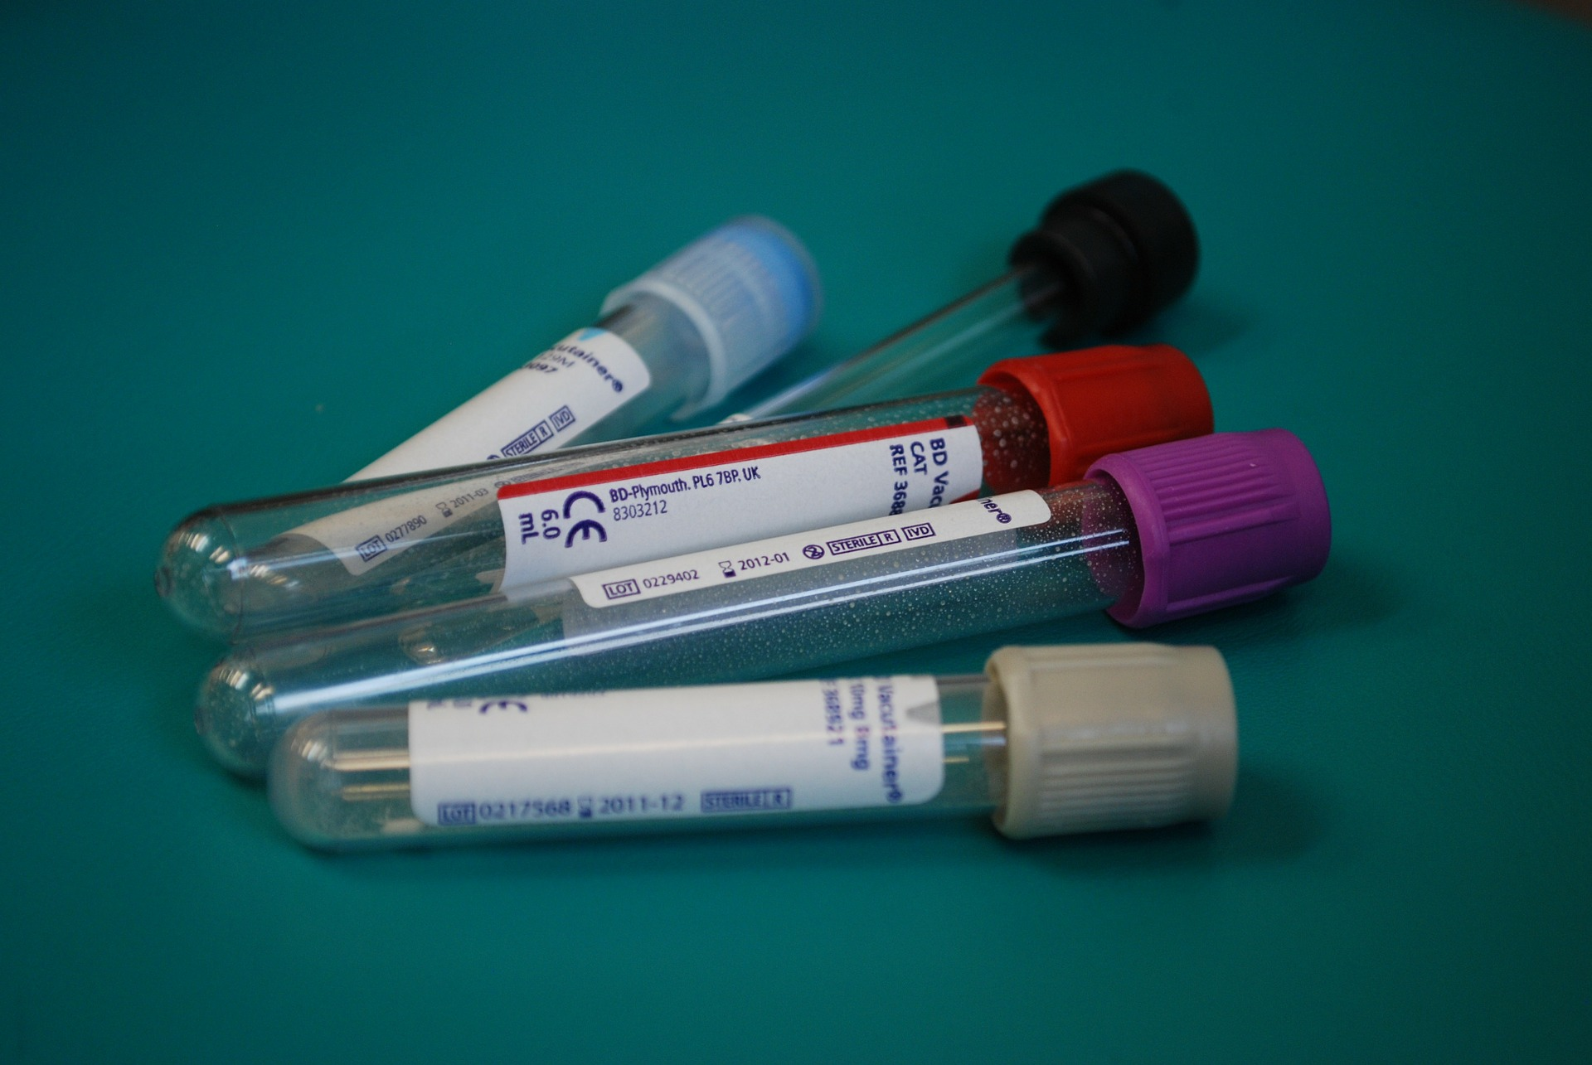
Nurse
Receive disease reports and confirm the existence of an outbreak
Interview patients
Collect samples for laboratory analysis
Develop programs to educate the public on any risks
Give mass vaccinations, if necessary

Slide 29
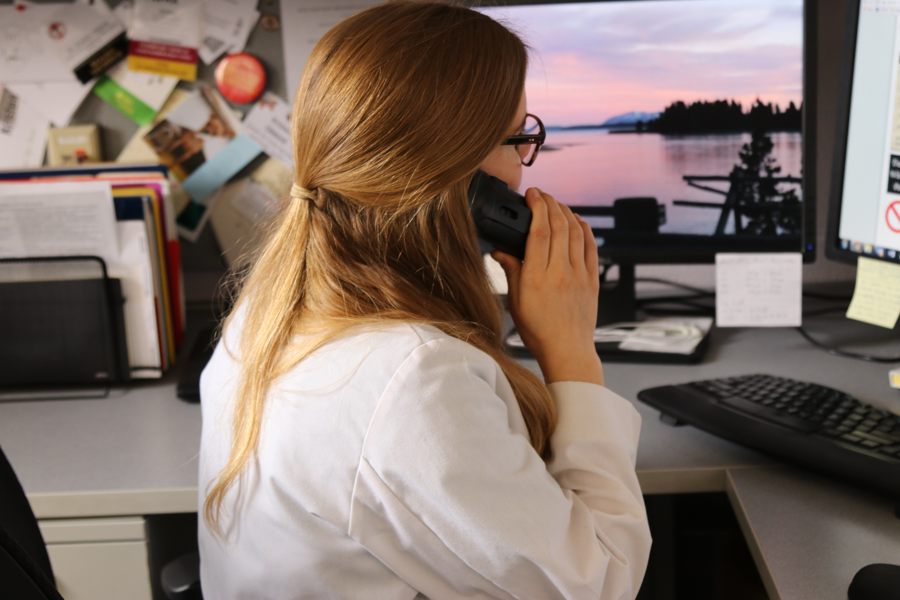
Physician
Recognize and report disease outbreaks in people
Manage and treat patients with disease
Warn patients of the risks of zoonotic disease transmission
Communicate with other health officials
Notes:
Photo source: Andrew Kingsbury, Iowa State University

Slide 30
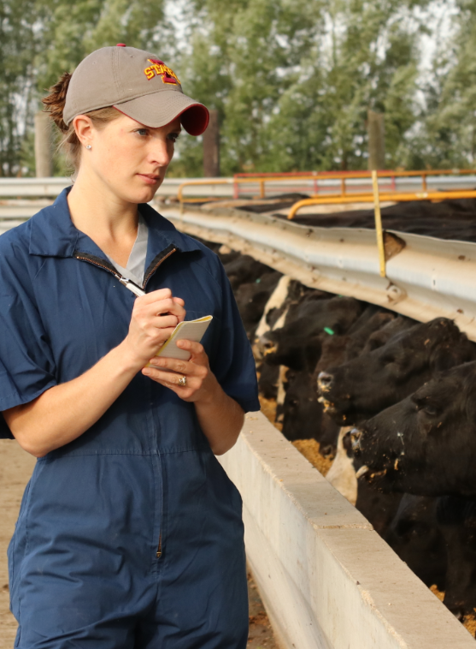
Veterinarian
Recognize and report disease outbreaks in animals and people
Assess the risk for potential zoonotic disease transmission in animals and people
Make prevention recommendations to prevent diseases shared between animals and people
Advise potentially exposed people to seek medical attention
Share their findings with human and animal health officials
Notes:
Photo source: Andrew Kingsbury, Iowa State University

Slide 31
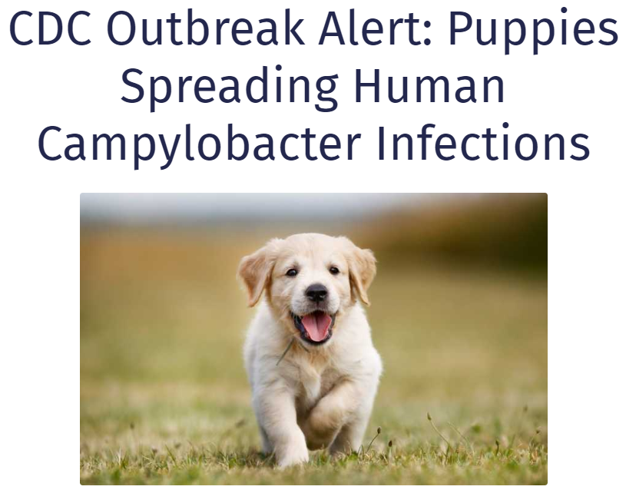
Public Health Veterinarian
Determine the cause of an outbreak
Provide recommendations for animal disease responders
Develop a plan to control and prevent further illness

